Slide 1
If people do not believe that mathematics is simple, it is only because they do not realize how complicated life is
John von Neumann

Slide 2
The Role of Population Games and Evolutionary Dynamics in Control
Nicanor Quijano
Full Professor
Universidad de los Andes
Thanks to Alain Vande Wouwer and all the organizers for the invitation
Notes:
Hello, my name is Nicanor Quijano, and I will show you the work that we have been doing in the last years on population games and evolutionary dynamics applied to control systems. I would like to thank Alain and all the organizers for the invitation.

Slide 3
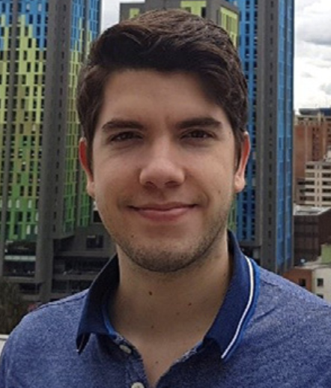


Based on a joint work with…
Juan Martínez-Piazuelo
Carlos Ocampo-Martínez
Germán Obando
Notes:
The work that I will show you today is based on a joint work with our PhD student Juan Martínez-Piazuelo; Prof. Carlos Ocampo-Martínez, from UPC Barcelona, and Prof. Germán Obando, from Univ del Rosario, Bogotá

Slide 4
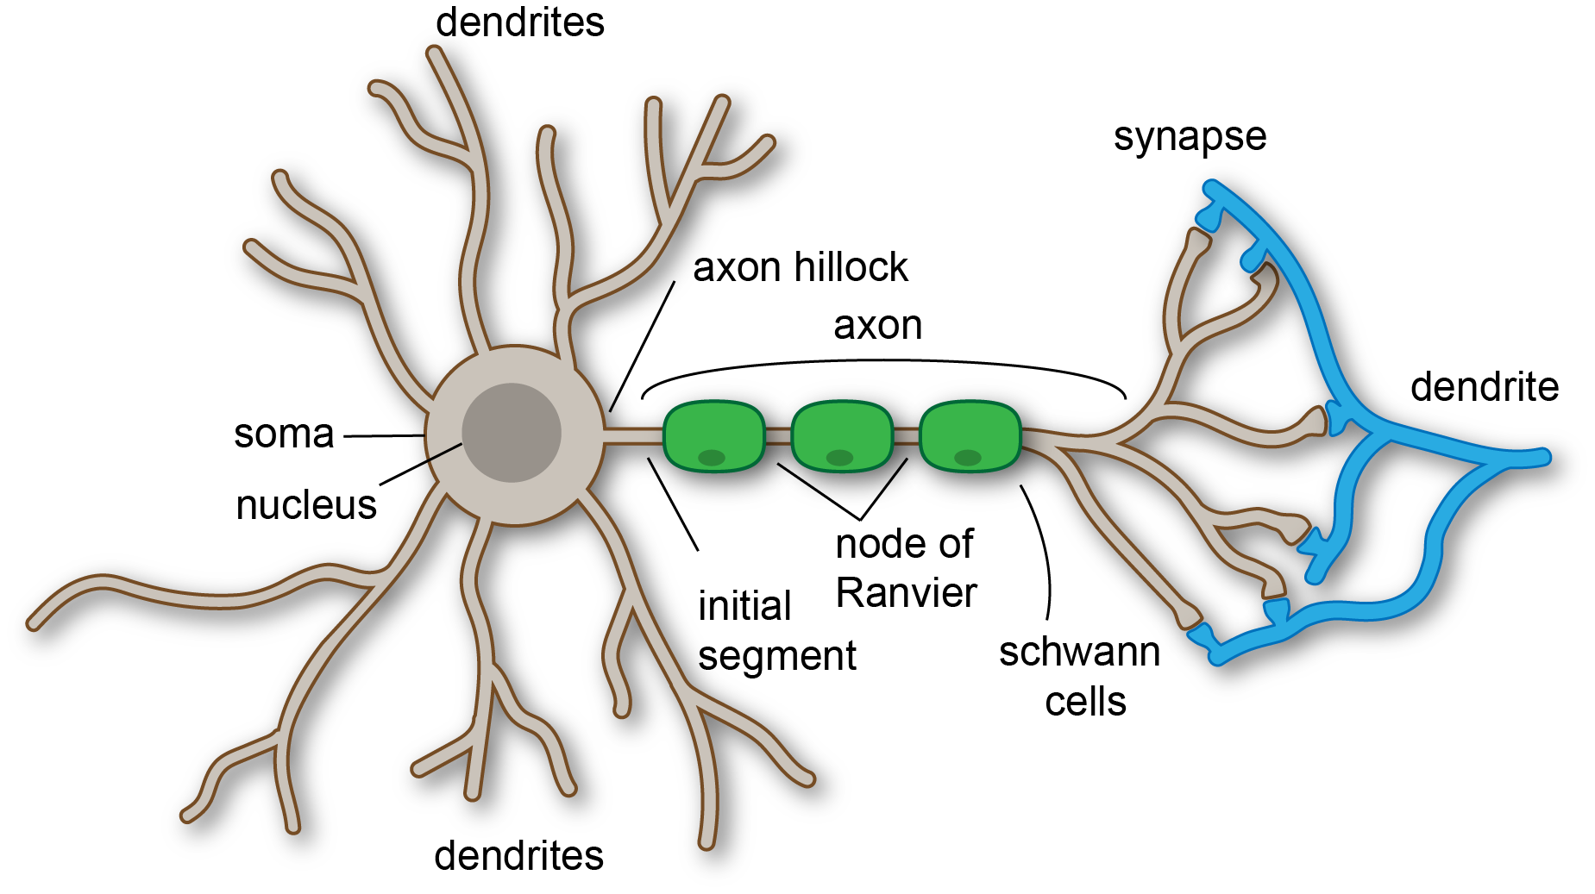
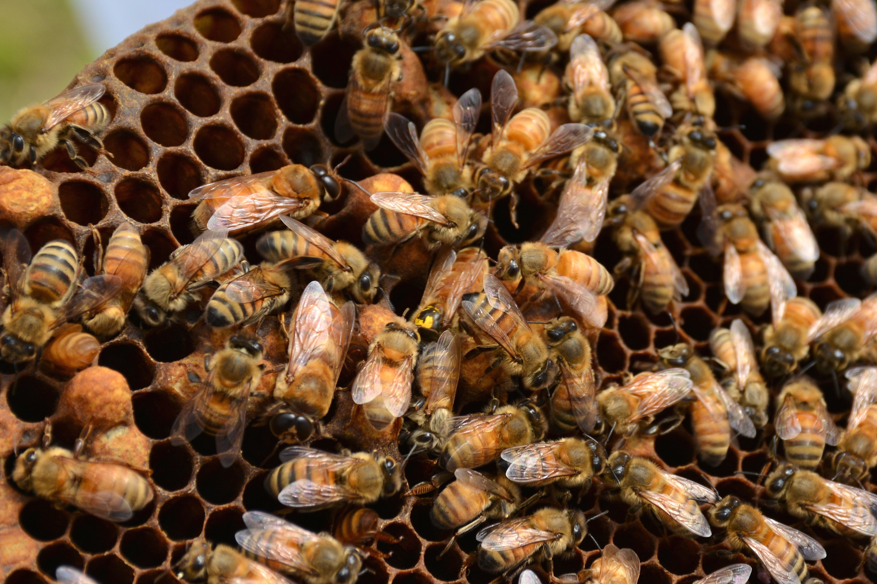
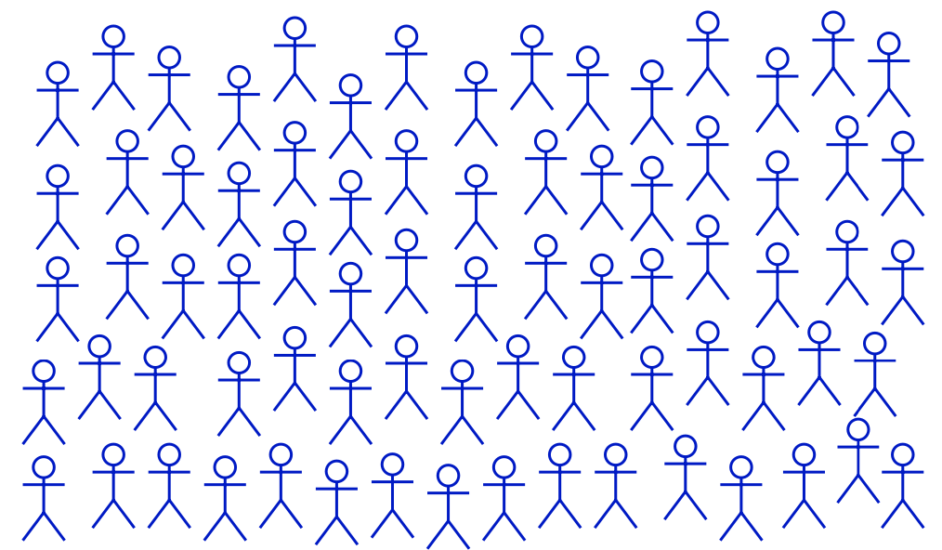
Motivation
Curtis Neveu, CC BY-SA 4.0 <https://creativecommons.org/licenses/by-sa/4.0>, via Wikimedia Commons
U.S. Geological Survey from Reston, VA, USA, CC0, via Wikimedia Commons
Notes:
In nature, whether there is a group of neurons, a colony of bees or humans in a community, there are some interactions between these individuals that lead to complex and unpredictable outcomes.
Whether humans in a community, ants in a colony, or neurons in a brain, simple decisions or actions by interacting individuals can lead to complex and
unpredictable outcomes in a population. The study of such systems typically presents a choice between micro- and macro-scale analysis. While there exist intricate micro-models of human decision processes, ant behaviors, and single neurons, assembling these high-dimensional components on a large scale most often results in models that are impenetrable to analysis, and therefore unlikely to reveal any useful properties of the collective dynamics.
Ref paper Cao

Slide 5











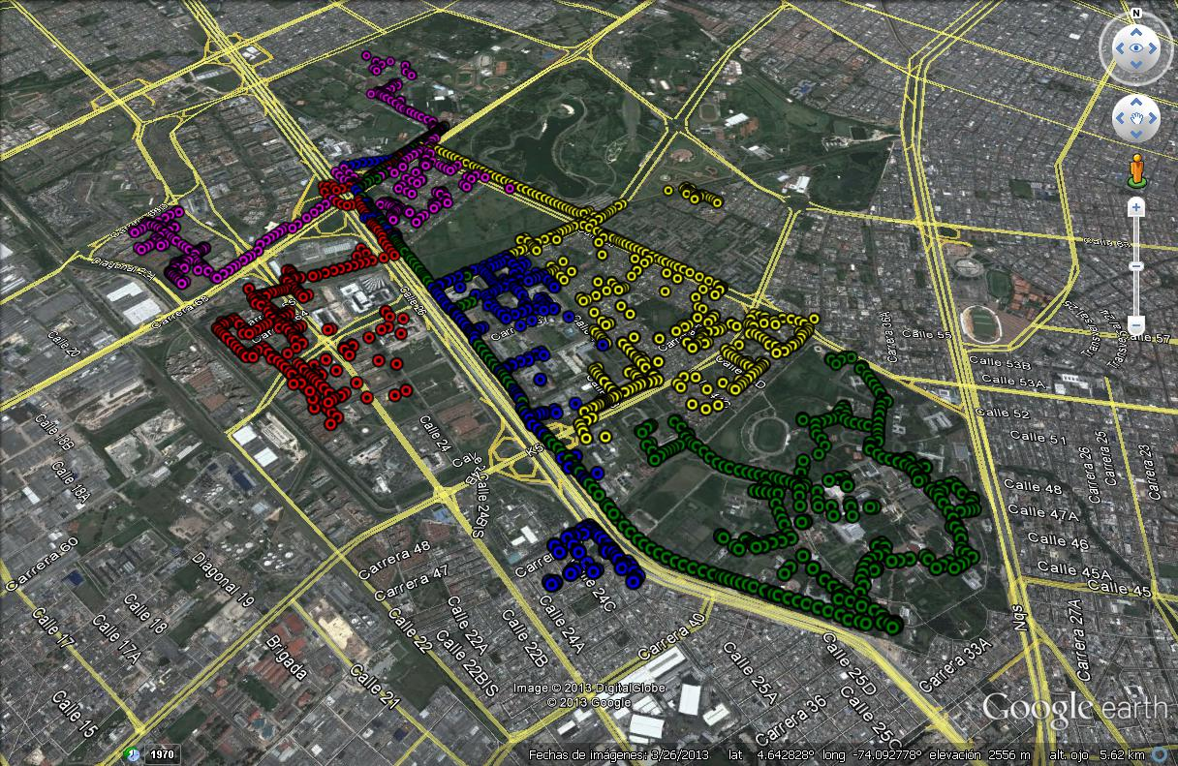
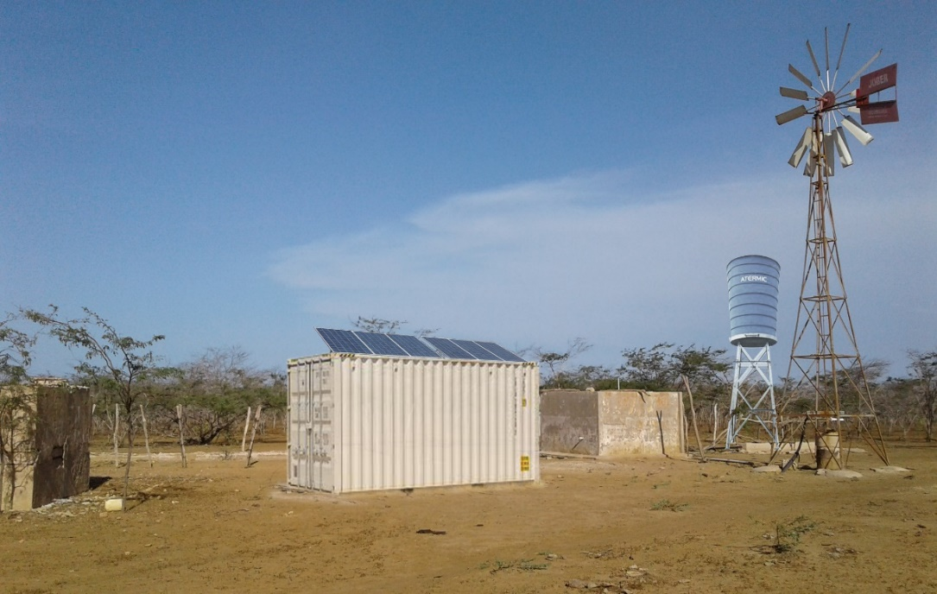
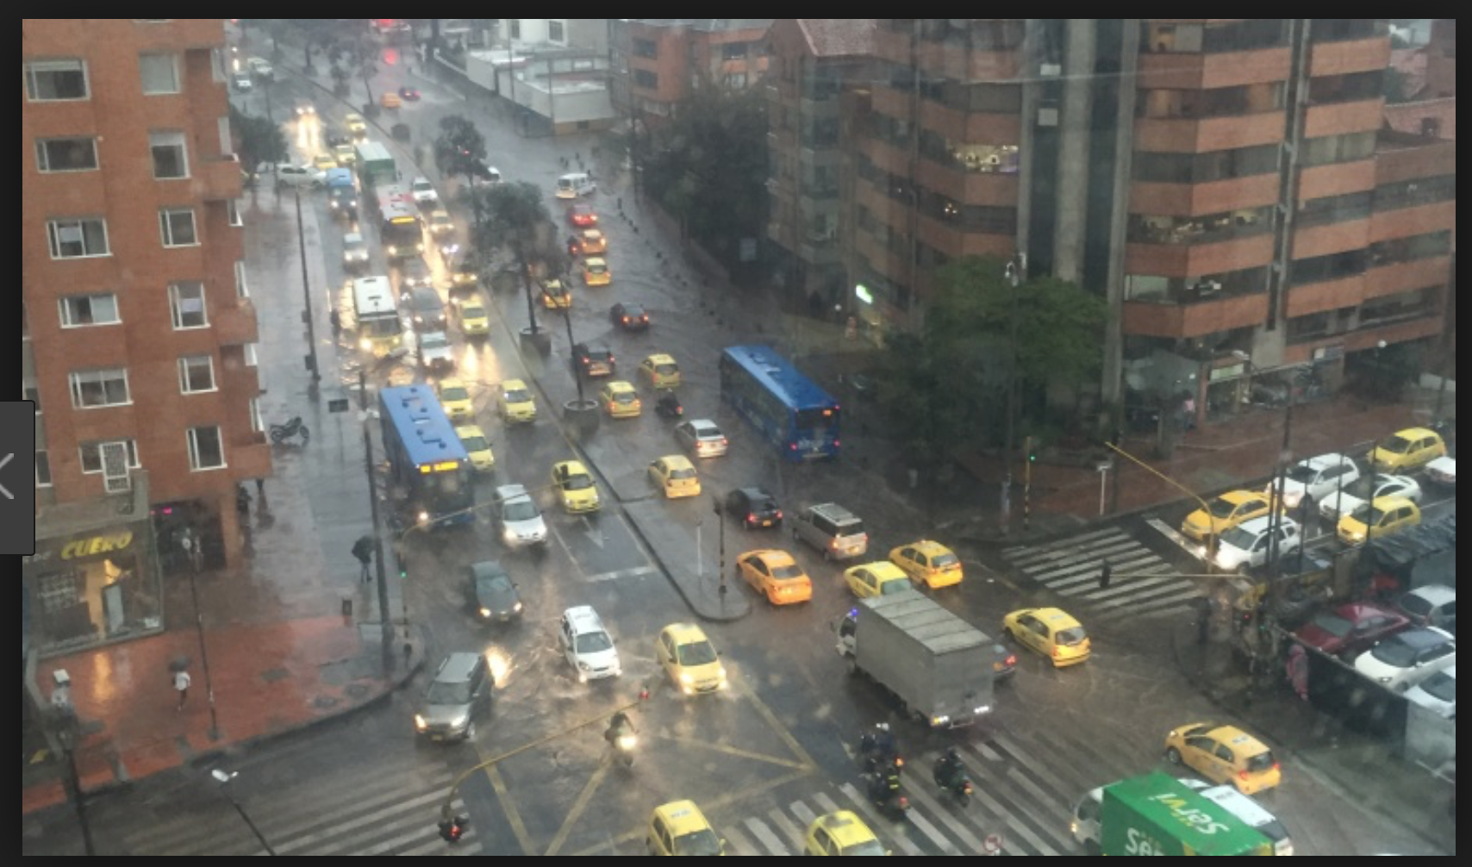
Photos adapted from www.bogota.gov.co, Caracol Radio, SILICE III and AE3-ISAGEN
Notes:
The same thing happens in infrastructure problems (e.g., problems in energy system integration, water distribution systems, or even traffic control). There are some studies in terms of micro and macro scale analysis. However, when we are assembling these high-dimensional components on a large scale most often results in models that are impenetrable to analysis, and therefore unlikely to reveal any useful properties of the collective dynamics.

Slide 6

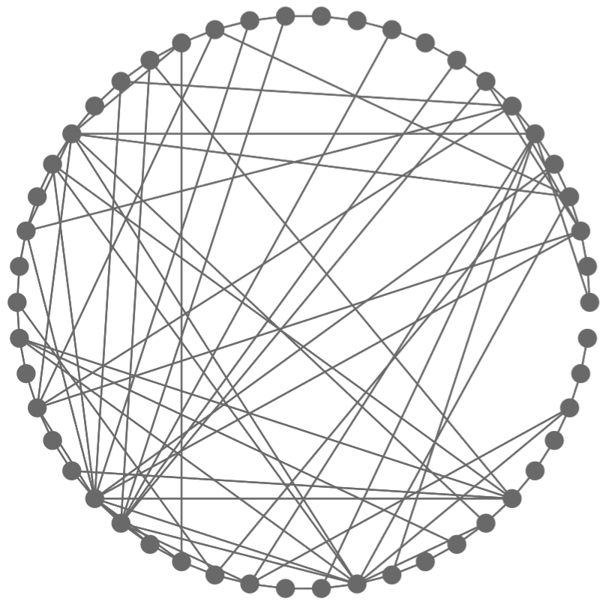
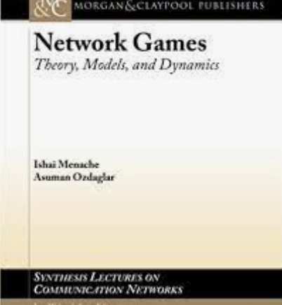
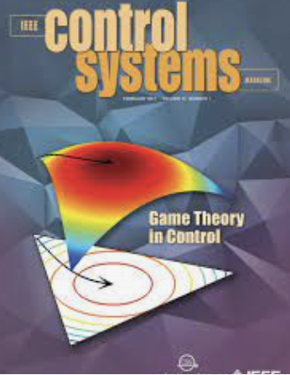
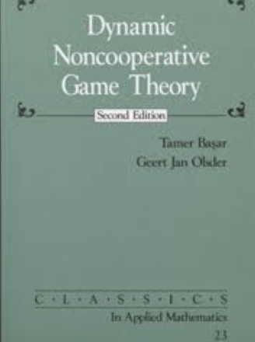

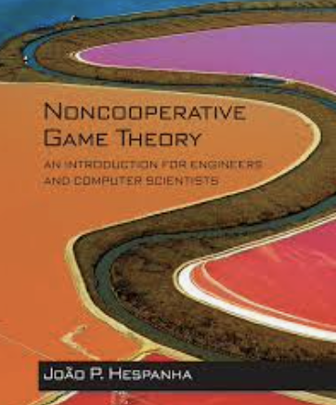
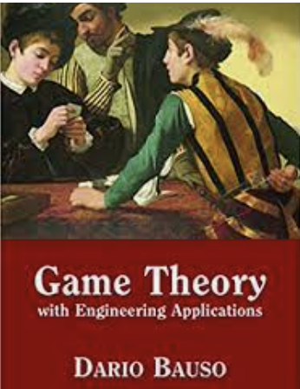

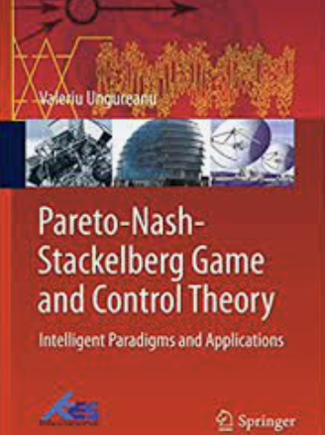
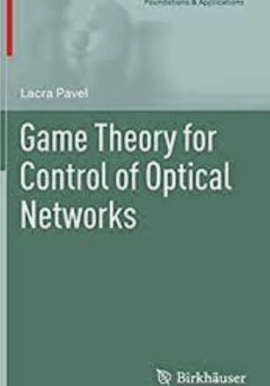
Motivation
Large-scale systems with many components
Systems distributed over networks
Notes:
All these problems can be seen as large-scale complex systems (LSCSs). These LSCSs refer to systems comprised of a large number of components, states, inputs, and/or outputs that interact with each other over some given environment. One can think of an LSCS as a system of several interacting subsystems with coupled dynamics and/or constraints. One problem that arises is when each of these sub-systems tries to maximize their own benefits. In order to address this type of problems, Game Theory has been found to be an interesting way to cope with it. As you can see, there have been several books and monographs that explain how game-theoretical methods can be used to solve some of this type of problems.

Slide 7
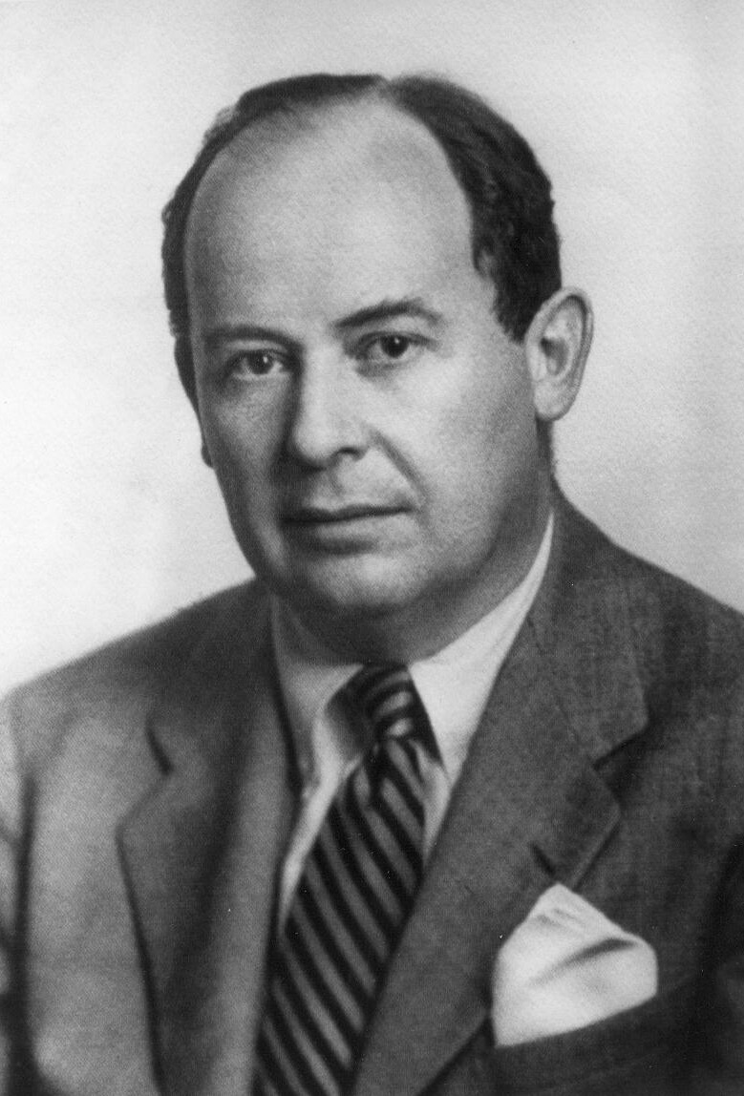
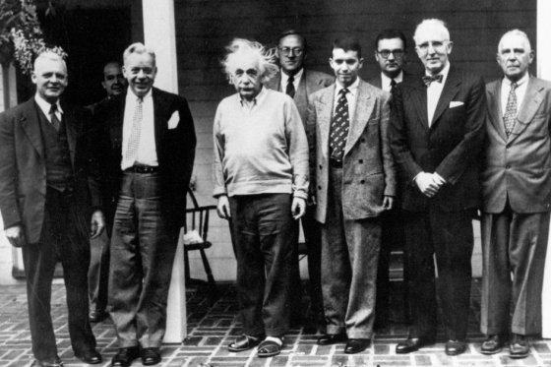
GT: Basic Concepts
Game theory is the name that is given to the methodology that uses math tools to model and analyze decision making situations.
In these situations, there are different actors that are involved (players), which have different objectives.
Each of the decisions taken affect directly to other players.
This theory tries to predict the behavior of the players and sometimes it suggests how the players should play in order to maximize their reward.
Photo adapted from El Espectador
NQS, C Ocampo, J Barreiro, G Obando, A Pantoja, EMojica, The role of population games and evolutionary dynamics in distributed control systems: The advantages of evolutionary game theory, IEEE Control Systems Magazine, 2017
Notes:
Game theory is the name that is given to the methodology that uses math tools to model and analyze decision making situations.
In these situations, there are different actors that are involved (players), which have different objectives.
Each of the decisions taken affect directly to other players.
This theory tries to predict the behavior of the players and sometimes it suggests how the players should play in order to maximize their reward.
The theory was developed by John von Neumann and Oskar Morgensten, two characters that appear in this picture. One small anecdote regarding the picture, is the fact that the person to the left of Einstein is Mario Laserna, one of the founders of Universidad de los Andes in 1948.
From left to right: D.Munro; J.Von Neumann; W.Oats; A.Einstein; O.Morgenstern; M.Laserna; S.Wilkes; M.Morse; S.Lefschetz.

Slide 8
Applications of Control and GT (1)
Charging of large populations of electric vehicles
S. Grammatico, F. Parise, M. Colombino, J. Lygeros, Decentralized convergence to Nash equilibria in constrained deterministic mean field control, IEEE Trans. Autom. Control, 2016
Coordination of robot networks
H. Jaleel, J. S. Shamma, Distributed optimization for robot networks: From real-time convex optimization to game-theoretic self-organization, Proc. IEEE, 2020
Control of epidemics
W. Lee, S. Liu, H. Tembine, W. Li, S. Osher, Controlling propagation of epidemics via mean-field control, SIAM J. Appl. Math., 2021
Notes:
As I said before, game theory has been used to address different problems. Just to name a few problems that have been addressed recently, we have the charging of electric vehicles, the coordination of robot networks, control of epidemics, learning control, demand response, or even regulation of water resources.

Slide 9
Applications of Control and GT (2)
Learning and control B. Gao, L. Pavel, On passivity, reinforcement learning, and higher order learning in multiagent finite games, IEEE Trans. Autom. Control, 2021
Demand response in electrical grid
F. Genis Mendoza, G. Konstantopoulos, D. Bauso, Online pricing for demand-side management in a low-voltage resistive micro-grid via a Stackelberg game with incentive strategies, IET Smart Grid, 2022
Water resource manufacturers and regulators to find an efficient water allocation in a river basin
Z. Lu, F. Cai, X. Wu, S. Zhang, S. Wu, Evolution of water resource allocation in the river basin between administrators and managers, Hydrol. Res., 2022
Notes:
As I said before, game theory has been used to address different problems. Just to name a few problems that have been addressed recently, we have the charging of electric vehicles, the coordination of robot networks, control of epidemics, learning control, demand response, or even regulation of water resources.

Slide 10
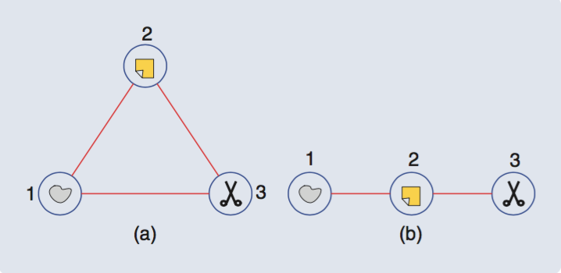
Type of Games
Matrix games: finite number of strategies. Once a player has taken a decision, the payoff will be given by a payoff matrix.
Continuous-static games: the strategies do not need to be discrete and the strategies and payoffs are given in continuous time.
Differential/Dynamic games: its main characteristic is that the strategies and payoffs are time-varying. ODEs or difference equations model the behavior.
 | Rock | Scissor | Paper
Rock | 0 | 1 | -1
Scissor | -1 | 0 | 1
Paper | 1 | -1 | 0
Game Theory and Learning for Wireless Networks, S.Lasauce and H.Tembine.
NQS, C Ocampo, J Barreiro, G Obando, A Pantoja, EMojica, The role of population games and evolutionary dynamics in distributed control systems: The advantages of evolutionary game theory, IEEE Control Systems Magazine, 2017
Notes:
There are several classes of games. The matrix games, where the strategies are finite and a payoff matrix will give the benefit received by the players (an example is the classical RSP game, described to your left). There are also continuous games; but we are more interested in this differential/dynamical games, where the strategies and payoffs are time-varying and its behavior can be modeled by ODEs or difference equations.

Slide 11
Problems of Dynamic Games
How to model the environment where the players interact?
ODEs possess most of the characteristics of the environment.
How to model the objectives of the players?
The objectives are given by payoff functions that should be optimized. However, there are some restrictions that should be included.
How to specify the order in which the decisions will take place, the type of information available and the evolution of the game?
Game Theory and Learning for Wireless Networks, S.Lasauce and H.Tembine.
Notes:
On these dynamic games, several problems arise. For instance, how to model the environment where the players interact (e.g., ODEs possess most of the characteristics of the environment); how to model the objectives of the players (which are given by payoff functions and some restrictions); and how to specify the order in which the decisions take place, the amount and type of information available and how the game evolves.

Slide 12
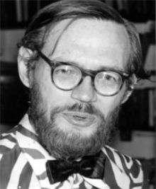
Type of Dynamic Games
Stackelberg
Standard Repeated Games
Stochastic Games
Differential Games
Evolutionary Games
Maynard-Smith, J.; Price, G. R. (1973). "The Logic of Animal Conflict". Nature. 246 (5427): 15–18.
https://mentesalternas.com/2014/01/george-price.html
https://www.science.org/content/article/john-maynard-smith-dies
Notes:
Between these dynamic games we find some very well known to the control community such as Stackelberg games, Stochastic and Differential Games. However, I would like to focus our attention in the evolutionary games. The first ideas in this area were developed by JMS and GP, in its seminal paper The logic of Animal Conflict in 1973.

Slide 13
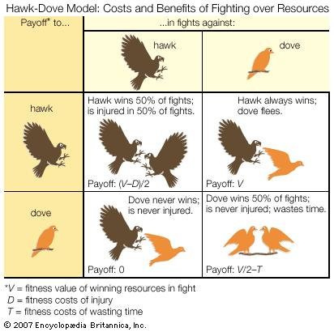
Evolutionary Games
EGT assumes a large population where the individuals use different strategies, which can be seen as different phenotypes.
In this case, the fitness (payoff proportional to the number of offsprings) depends on the quantity and relative frequency of other individuals in the population ➔ survival of the fittest
The seminal paper by TaJo78 presented some dynamics that could be studied from the general theory of systems.
PD Taylor, LB Jonker, Evolutionary stable strategies and game dynamics, Mathematical biosciences, 1978
https://en.wikipedia.org/wiki/Evolutionary_game_theory#cite_note-Price-1
Notes:
EGT assumes a large population where the individuals use different strategies, which can be seen as different phenotypes. For instance, in the hawk-dove game you have some aggressive or passive behaviors that will be replicated from generation to generation.
In this case, the fitness (payoff propotional to the number of offsprings) depends on the quantity and relative frequency of other individuals in the population → survival of the fittest (this is linked to the MSPr on evolutionarily stable strategy).
For some time, the biological description of the ESS concept and the evolution of the game were described as the classical matrix approach.
However, in 1978 the seminal paper by TaJo78 presented some dynamics that could be studied from the general theory of systems. These were the classical replicator dynamics.

Slide 14
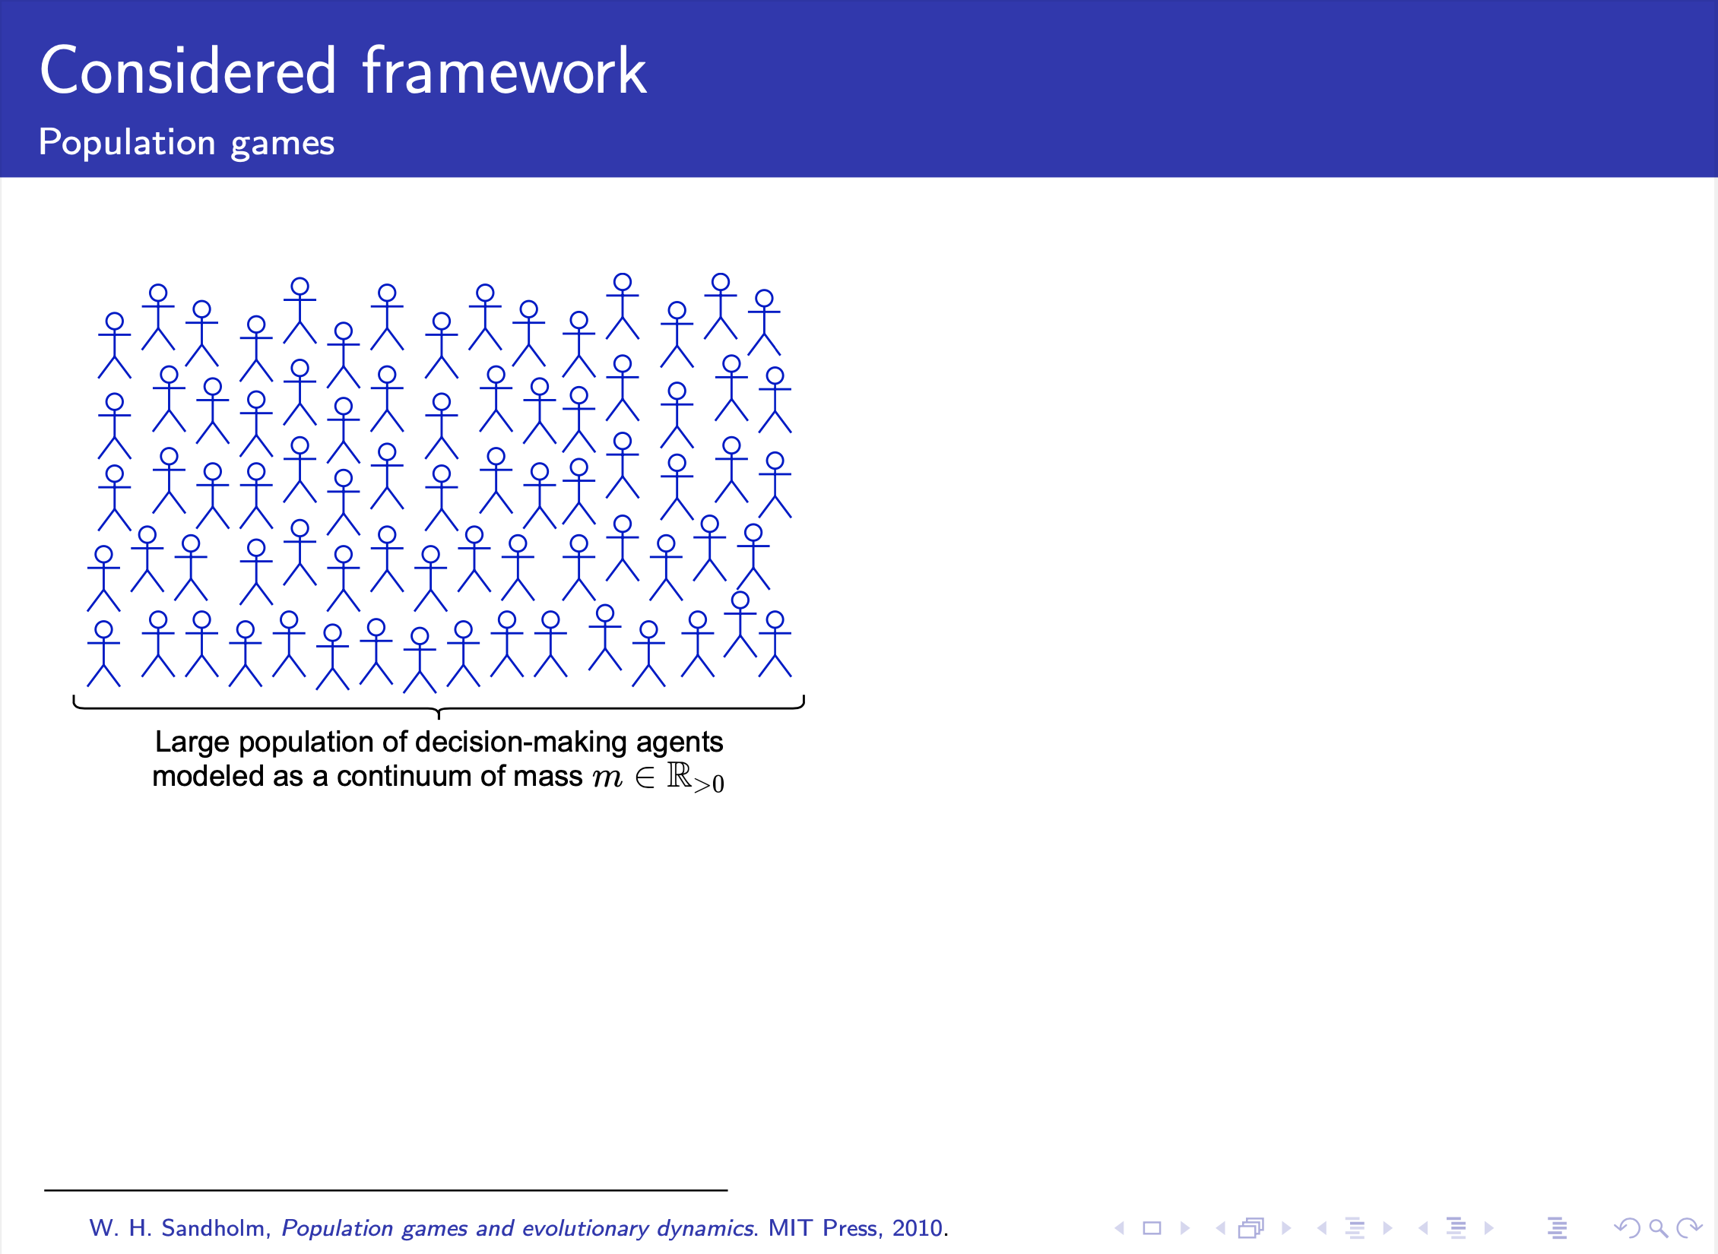
Notes:
Differently from the approach used by MS-Pr and TaJo In our case, we are going to consider the following framework. Let us consider a large population of decision making agents, modeled as a continuum of positive mass m.

Slide 15
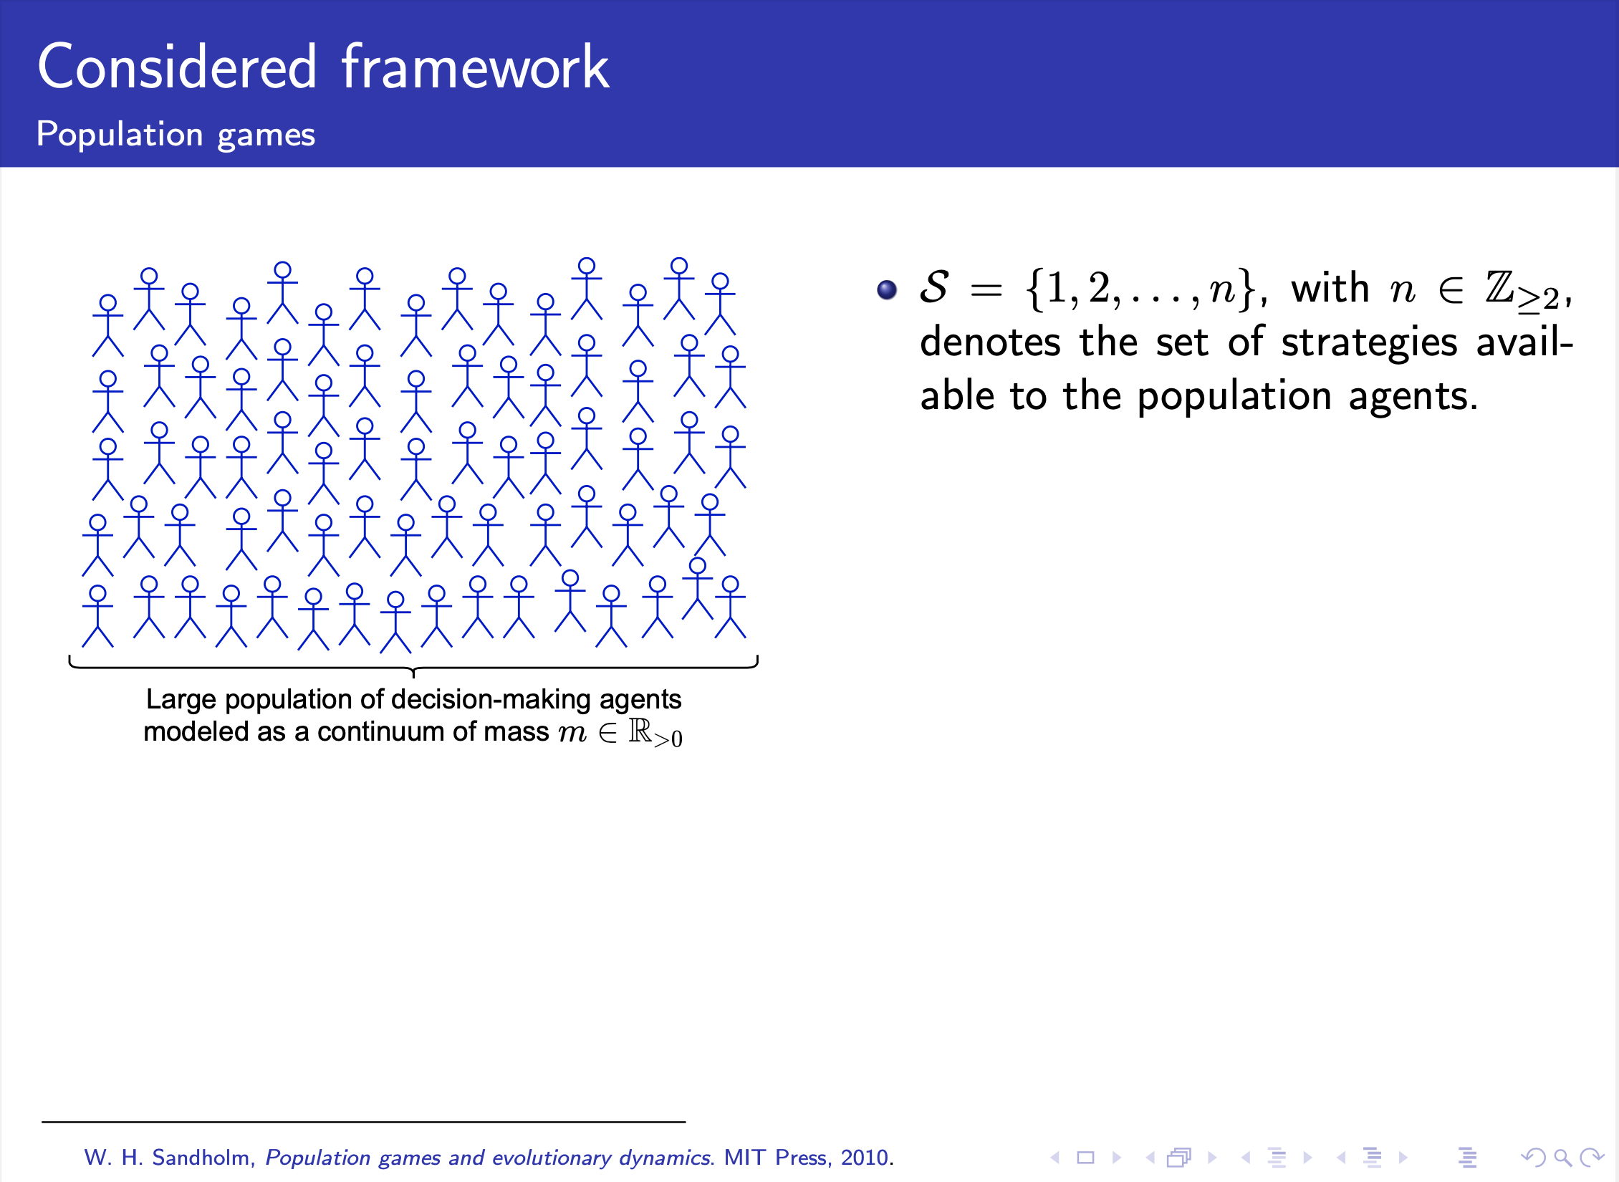
Notes:
the set of strategies available is S, where n is the total number of available strategies

Slide 16
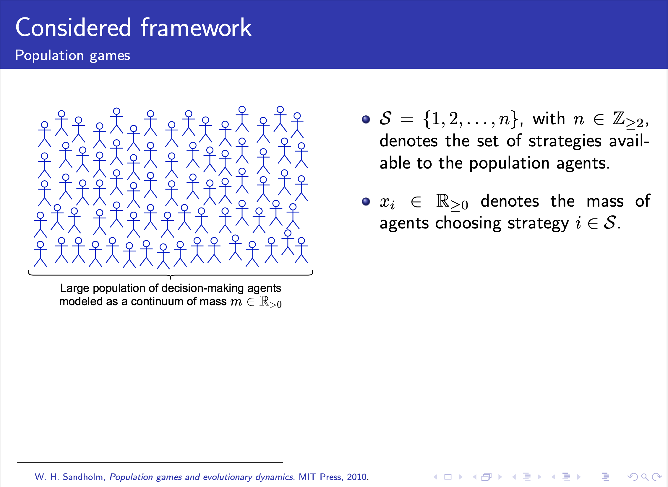
Notes:
On the other hand, the amount of individuals that chooses a given strategy is denoted by x_i.

Slide 17
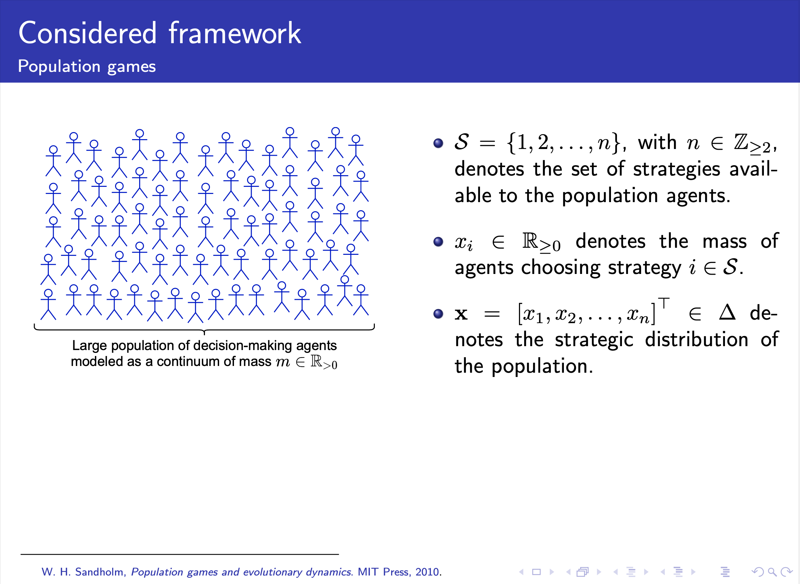
Notes:
Bold x denotes the strategic distribution of the population, and this vector belongs to the set Delta

Slide 18
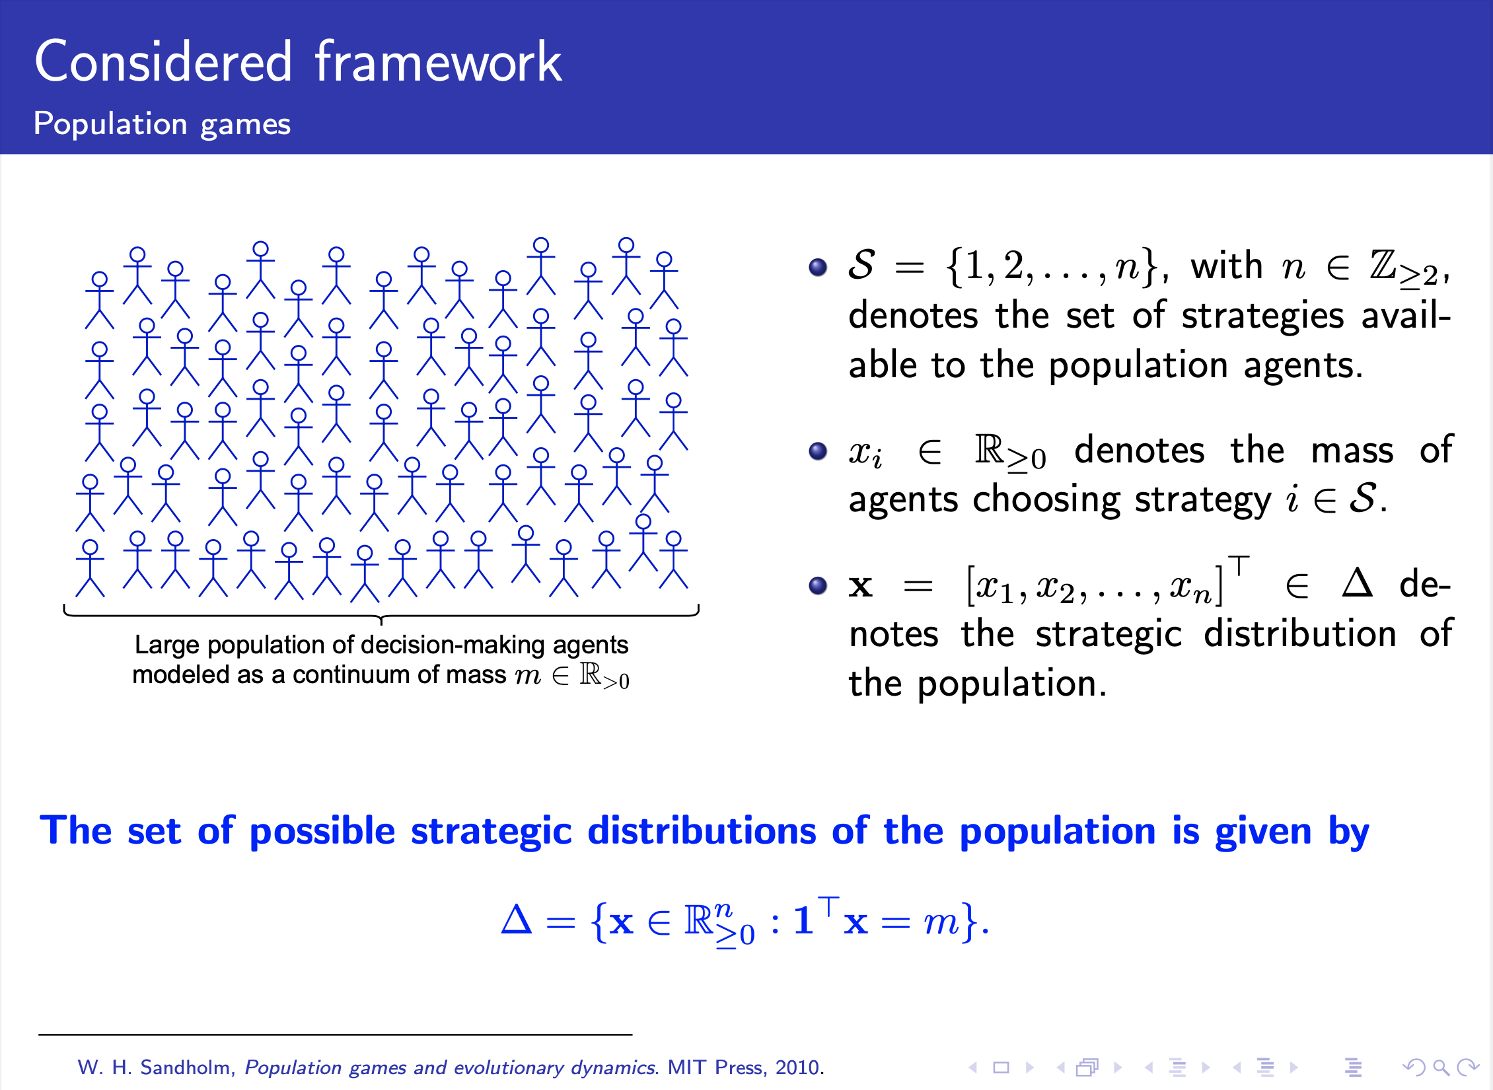
Notes:
Which is the set of possible strategic distribution of the population is Delta. As we can see, the sum of all x_i over the n strategies should be constant and equal to the continuum of mass m.

Slide 19
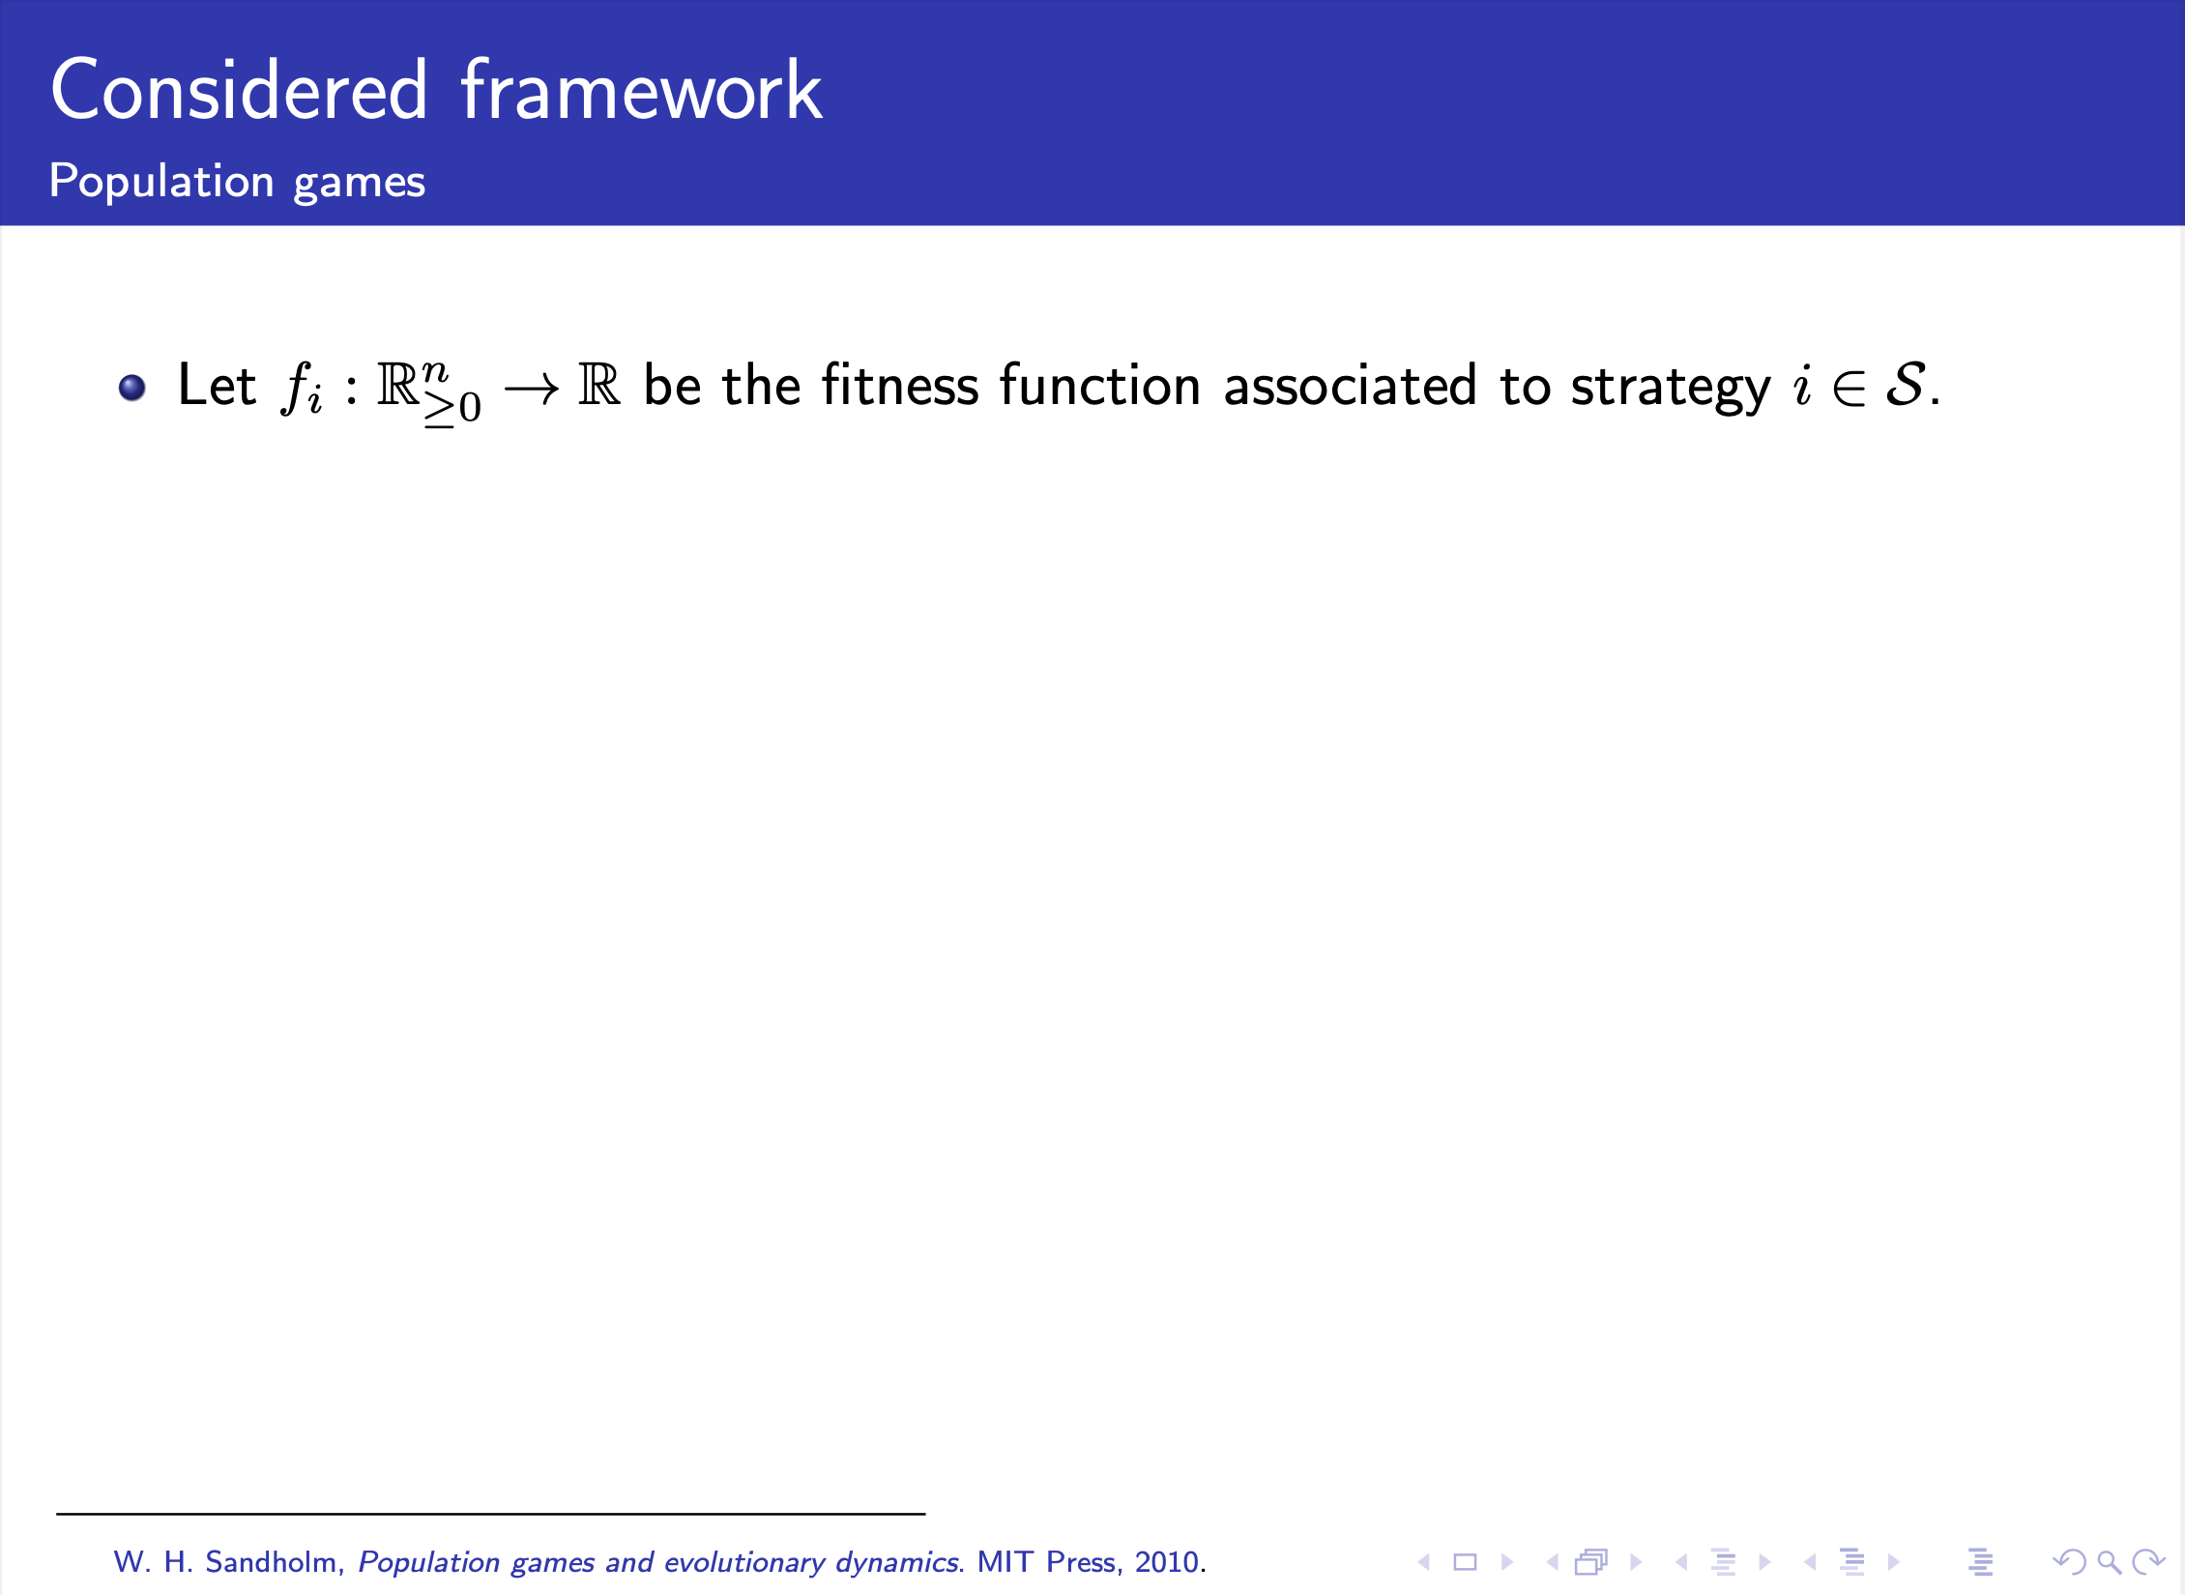
Notes:
On the other hand, let us consider f_i to be the fitness function associate to the ith strategy,

Slide 20
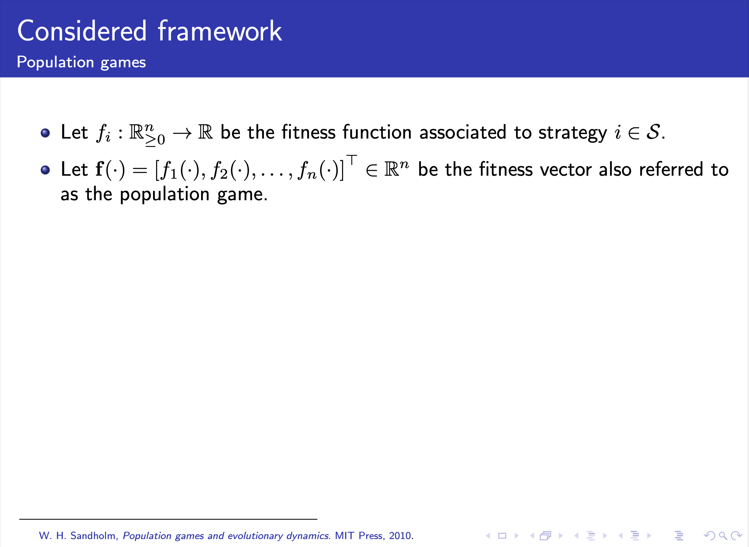
Notes:
where f is the fitness vector. In the classical approach, this can also be referred to as the population game.

Slide 21
William Sandholm, Population games and evolutionary dynamics, MIT Press, 2010
Wu, D. Z. and R. S. and M. W. C. and R. L. and J. Tributes to Bill Sandholm. Journal of Dynamics and Games, 2022
Notes:
The approach that we follow is based on the ideas of William Sandholm. Let us start with a well mixed population, where x corresponds to the strategic distribution of the population.

Slide 22
William Sandholm, Population games and evolutionary dynamics, MIT Press, 2010
Wu, D. Z. and R. S. and M. W. C. and R. L. and J. Tributes to Bill Sandholm. Journal of Dynamics and Games, 2022
Notes:
This vector x is taken by the fitness vector (or payoff vector) to for the population game. There are works that prefer to use the name payoff dynamics model instead of population game as will see next. In the conventional framework, the payoff and the fitnesses are the equal. In other cases, there could be some dynamics involved.
\begin{itemize}
\item \textcolor{blue}{In more general contexts, the fitness vector is seen as a payoff vector, which could be static or dynamic.}
\item \textcolor{blue}{There are works that prefer to use payoff dynamics model instead of population game.}
\item \textcolor{blue}{In the conventional framework
\[ p_i(t) = f_i(\mathbf{x}(t)), \;\; \forall \; i \in \mathcal{S}. \]}
\end{itemize}

Slide 23
William Sandholm, Population games and evolutionary dynamics, MIT Press, 2010
Wu, D. Z. and R. S. and M. W. C. and R. L. and J. Tributes to Bill Sandholm. Journal of Dynamics and Games, 2022
Notes:
According to a Poisson process, a revision opportunity arises. The reason of the Poisson process is to make the dynamic differentiable with respect to infinitesimal change in time. The agent analyses the new candidate strategy and decides whether to witch or not.
\begin{itemize}
\item \textcolor{red}{According to a Poisson process a revision opportunity arises.}
\item \textcolor{red}{Agent analyses the new candidate strategy and decides whether to switch or not.}
\end{itemize}

Slide 24
William Sandholm, Population games and evolutionary dynamics, MIT Press, 2010
Wu, D. Z. and R. S. and M. W. C. and R. L. and J. Tributes to Bill Sandholm. Journal of Dynamics and Games, 2022
Notes:
Finally, the dynamics for x are defined. These are called the mean dynamics, and its analysis is based on a selection and comparison based on the fitness. In this case, we obtain the amount of agents who have selected a given strategy and those who have decided to switch.
\begin{itemize}
\item The analysis is based on a selection and comparison based on the fitnesses.
\item For each strategy, we obtain the amount of agents who have selected it and those who have decided to switch
\end{itemize}

Slide 25
William Sandholm, Population games and evolutionary dynamics, MIT Press, 2010
Wu, D. Z. and R. S. and M. W. C. and R. L. and J. Tributes to Bill Sandholm. Journal of Dynamics and Games, 2022
Notes:
Depending on the revision protocol, we get different type of dynamics. In the table you can see some of the classical ones, especially the replicator and Smith dynamics that we are going to use in our examples.
\begin{table}[htp]
%\caption{default}
\begin{center}
\begin{tabular}{|c|c|}
\hline Revision Protocol ($\forall i, j \in \mathcal{S}$) & Resultant Evolutionary Dynamics \\ \hline
$ \rho_{ij}(t) = \left[f_j(t) - \frac{1}{m} \sum_{l \in \mathcal{S}} x_l(t) f_l(t) \right]_+ $ & Brown-von Neumann-Nash Dynamics \\
$ \rho_{ij}(t) = x_j(t)\left[f_j(t) - f_i(t) \right]_+ $ & Replicator Dynamics \\
$ \rho_{ij}(t) = \left[f_j(t) - f_i(t) \right]_+ $ & Smith Dynamics \\ \hline
\end{tabular}
\end{center}
\label{default}
\end{table}

Slide 26
General Structure
J. Martinez-Piazuelo, C.Ocampo-Martinez, NQS, Distributed Nash Equilibrium Seeking in Strongly Contractive Aggregative Population Games, Submitted IEEE Transactions on Automatic Control, 2022
S. Park, N. C. Martins, and J. S. Shamma, “From population games to payoff dynamics models: A passivity-based approach,” in Proceedings of the 58th IEEE Conference on Decision and Control (CDC), 2019, pp. 6584–6601.
Notes:
The structure presented before can be summarized in this general one scheme, which is inspired by the work by Park-Martins-Shamma, where a feedback interconnection is shown. In this case, we have two blocks, one that describes the evolutionary dynamics model or EDM, and the other one that describes the population dynamics model or PDM. The PDM can have a static or a dynamic payoffs, which will depend on the application as we will see in the two examples that we will present.

Slide 27
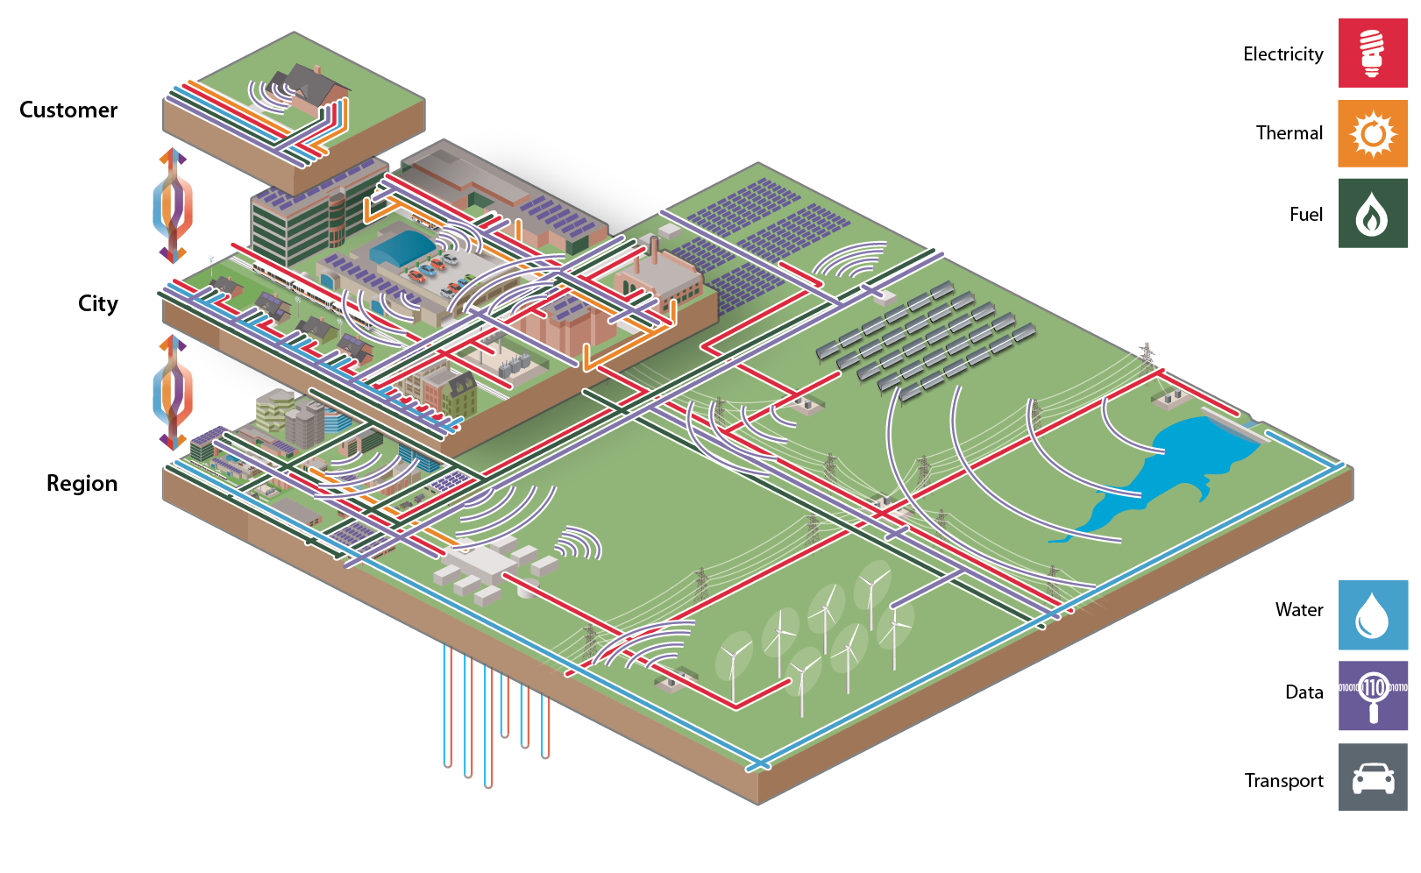
Approach
DRA
G.Obando, NQS, C.Ocampo-Martinez, Decentralized Control for Urban Drainage Systems using Replicator Dynamics. IEEE Acces, 2022.
J.Martinez-Piazuelo, NQS, C.Ocampo-Martinez, A Payoff Dynamics Model for Equality-Constrained Population Games. IEEE Control Syst Lett 6, 530–535 (2022).
Notes:
Therefore, in this presentation we will focus on large scale complex distributed systems that address distributed resource allocation problems, which can be solved using game theoretical concepts. In particular, we use the EDM-PDM approach, where we will use two different forms of looking at the PDM.

Slide 28
Agenda
Considered Framework
Decentralized Control for Urban Drainage Systems Using Replicator Dynamics
A Payoff Dynamics Model for Equality-Constrained Population Games
Concluding Remarks
Notes:
Until now, we have seen the considered framework and the motivation of our presentation. Now, we will focus on two problems. First, we will talk about the decentralized control for urban drainage systems using one of the dynamics presented before: the replicator dynamics. Then, we will present another approach where the payoff dynamics model includes constraints, where a congestion game is the application used to show the main theoretical results obtained in this work.

Slide 29
“The challenges facing engineering today are not those of isolated locales, but of the planet as a whole and all the planet’s people”
NAE 14 Grand Challenges

Slide 30
Decentralized Control for Urban Drainage Systems Using Replicator Dynamics
G.Obando, NQS, C.Ocampo-Martinez, Decentralized Control for Urban Drainage Systems using Replicator Dynamics. IEEE Acces, 2022.

Slide 31
Urban Drainage Systems
Figure: Flooding in Bogotá. www.bogota.gov.co.
Notes:
Overflooding occurs when the wastewater exceeds the storage capacity of any of the UDS’s collectors ➔ can be avoided if wastewater is efficiently allocated among all the UDS’s collectors by handling the system’s actuators (valves in our case).

Slide 32
Overflooding Problem
Key idea: Reaching an efficient wastewater allocation. Our objective is trying that all UDS’s collectors have the same empty space during most of the time.
Decentralized control strategies suit best for these kinds of systems, i.e., we are looking to design a set of controllers, where each controller is in charge of part of the UDS.
Divide our strategy in two main stages:
UDS is partitioned in sub-systems that have some desired characteristics
A local controller based on population dynamics is designed for each sub-system obtained in the partitioning stage.
Notes:
Key idea: Reaching an efficient wastewater allocation. Our objective is trying that all UDS’s collectors have the same empty space during most of the time.
Decentralized control strategies suit best for these kinds of systems, i.e., we are looking to design a set of controllers, where each controller is in charge of part of the UDS.
Divide our strategy in two main stages:
UDS is partitioned in sub-systems that have some desired characteristics
A local controller based on population dynamics is designed for each sub-system obtained in the partitioning stage.

Slide 33
Graph Model of a UDS: Divergent Topology
Involves n + 1 reservoirs and represents a situation in which there are n > 1 receptor reservoirs and only one source reservoir.
In a divergent topology there are n manipulated ﬂows diverging from a unique source reservoir.
Represented as a graph where the nodes are the source reservoir and the receptor reservoirs, and the edges are the links between the source and receptor reservoirs.
G.Obando, NQS, C.Ocampo-Martinez, Decentralized Control for Urban Drainage Systems using Replicator Dynamics. IEEE Acces, 2022.
Notes:
The UDS is partitioned in two type of topologies. The first one, the divergent topology Involves n + 1 reservoirs and represents a situation in which there are n > 1 receptor reservoirs and only one source reservoir.
In a divergent topology there are n manipulated ﬂows diverging from a unique source reservoir.
Represented as a graph where the nodes are the source reservoir and the receptor reservoirs, and the edges are the links between the source and receptor reservoirs.

Slide 34
Graph Model of a UDS: Convergent Topology
Involves n + 1 reservoirs and represents a situation in which there are n ≥ 1 source reservoirs and only one receptor reservoir.
In a convergent topology there are n manipulated ﬂows converging to a unique receptor reservoir.
Represented as a graph where the nodes are the receptor reservoir and the source reservoirs, and the edges are the links between the source and receptor reservoirs.
G.Obando, NQS, C.Ocampo-Martinez, Decentralized Control for Urban Drainage Systems using Replicator Dynamics. IEEE Acces, 2022.
Notes:
The second topology is the convergent one. It Involves n + 1 reservoirs and represents a situation in which there are n ≥ 1 source reservoirs and only one receptor reservoir.
In a convergent topology there are n manipulated ﬂows converging to a unique receptor reservoir.
Represented as a graph where the nodes are the receptor reservoir and the source reservoirs, and the edges are the links between the source and receptor reservoirs.

Slide 35
Graph Model of a UDS
One a sub-system has only one source reservoir and one receptor reservoir, then it can be represented as a convergent topology (divergent topologies require at least two receptor reservoirs).
We use the Muskingum model, which is based on the principle of mass conservation.
We represent each channel of the UDS as a reservoir containing a wastewater volume v_i(t).
G.Obando, NQS, C.Ocampo-Martinez, Decentralized Control for Urban Drainage Systems using Replicator Dynamics. IEEE Acces, 2022.
Notes:
One a sub-system has only one source reservoir and one receptor reservoir, then it can be represented as a convergent topology (divergent topologies require at least two receptor reservoirs).
We use the Muskingum model, which is based on the principle of mass conservation.
We represent each channel of the UDS as a reservoir containing a wastewater volume v_i(t).

Slide 36
System Partitioning
Partitioning consists in dividing the whole UDS in sub-systems belonging to the two topologies described before.
Partitioning must satisfy the following constraints:
All resulting sub-systems must belong to one and only one topology (convergent or divergent). This is required because we only design two types of controllers, one per each topology.
All reservoirs of the UDS must belong to at least one sub-system. If one reservoir does not belong to any subsystem, its wastewater volume would not be controlled.
Each edge of the graph that models the UDS must belong to one and only one sub-system.
Any partitioning algorithm satisfying these three constraints is suitable for the splitting of UDS.
Notes:
Partitioning consists in dividing the whole UDS in sub-systems belonging to the two topologies described before.
Partitioning must satisfy the following constraints:
All resulting sub-systems must belong to one and only one topology (convergent or divergent). This is required because we only design two types of controllers, one per each topology.
All reservoirs of the UDS must belong to at least one sub-system. If one reservoir does not belong to any subsystem, its wastewater volume would not be controlled.
Each edge of the graph that models the UDS must belong to one and only one sub-system.
Any partitioning algorithm satisfying these three constraints is suitable for the splitting of UDS.

Slide 37
Proposed Algorithm
G.Obando, NQS, C.Ocampo-Martinez, Decentralized Control for Urban Drainage Systems using Replicator Dynamics. IEEE Acces, 2022.
Notes:
The proposed algorithm for the partitioning is divided in 3 steps: the identification of the topologies, the removal of edges of divergent topologies, and finally the identification of convergent topologies.

Slide 38
Example of Partitioning
G.Obando, NQS, C.Ocampo-Martinez, Decentralized Control for Urban Drainage Systems using Replicator Dynamics. IEEE Acces, 2022.
Notes:
Let us take a simple example to illustrate how it is done. In this case, we have 7 tanks, which can be interpreted as a graph.

Slide 39
G.Obando, NQS, C.Ocampo-Martinez, Decentralized Control for Urban Drainage Systems using Replicator Dynamics. IEEE Acces, 2022.
Notes:
Figure shows the result of applying the first step of the algorithm. All nodes having more than one out-neighbor (nodes 1 and 4) are source nodes of a divergent topology. Receptors of node 1 are nodes 3 and 4, and receptors of node 4 are nodes 5 and 6. Therefore, there are two sub-systems with divergent blue red.

Slide 40
G.Obando, NQS, C.Ocampo-Martinez, Decentralized Control for Urban Drainage Systems using Replicator Dynamics. IEEE Acces, 2022.
Notes:
Next, the second step looks for the edges of sub-systems with divergent topology (which are depicted using dashed lines) are subtracted from the original graph.

Slide 41
G.Obando, NQS, C.Ocampo-Martinez, Decentralized Control for Urban Drainage Systems using Replicator Dynamics. IEEE Acces, 2022.
Notes:
Finally, we apply the third step of the algorithm. Nodes having at least one in-neighbor (in this case, nodes 4 and 7) are receptor nodes of convergent topologies, i.e.,Vr={4,7}. Node 2 is the source of node 4, and nodes 5 and 6 are sources of node 7. Thus, there are two sub-systems with convergent topology: green and purple.

Slide 42
Source reservoir's wastewater volume
Parameter that depends on the geometry of the source reservoir
Opening percentage of the valve that connects the source reservoir
Coefficient related to the external outflow of the reservoir
G.Obando, NQS, C.Ocampo-Martinez, Decentralized Control for Urban Drainage Systems using Replicator Dynamics. IEEE Acces, 2022.
Notes:
For convention, we use the indices 1, . . . , n, for identifying receptor reservoirs, while the source reservoir is marked with the index n + 1.
In our game, each player has two options: increase the opening percentage of one of the tanks’ valves, or decrease such a percentage for all the valves. If the player chooses the ﬁrst option, then it must also select one of the n valves that connect the source tank with its n receptor tanks. Thus, we have n + 1 available strategies, i.e., the strategy set is S = {1, . . . , n + 1}.
Strategies 1, . . . , n, increase the opening percentage of the corresponding receptor tank, i.e., if a player selects the i-th strategy, where i = 1, . . . , n, then the opening percentage of the i-th receptor tank’s valve increases. In this regard, the population playing this i-th strategy is exactly the opening percentage of the i-th receptor tank’s valve, i.e., xi(t). On the other hand, if a player adopts the strategy n + 1, it decreases the opening percentage of all valves. In this case, the population playing the strategy n + 1, i.e., xn+1(t), does not have a physical meaning. However, it is equal to the sum of the remaining opening percentages of all valves.

Slide 43
Receptor reservoirs' wastewater volume
G.Obando, NQS, C.Ocampo-Martinez, Decentralized Control for Urban Drainage Systems using Replicator Dynamics. IEEE Acces, 2022.
Notes:
For convention, we use the indices 1, . . . , n, for identifying receptor reservoirs, while the source reservoir is marked with the index n + 1.
In our game, each player has two options: increase the opening percentage of one of the tanks’ valves, or decrease such a percentage for all the valves. If the player chooses the ﬁrst option, then it must also select one of the n valves that connect the source tank with its n receptor tanks. Thus, we have n + 1 available strategies, i.e., the strategy set is S = {1, . . . , n + 1}.
Strategies 1, . . . , n, increase the opening percentage of the corresponding receptor tank, i.e., if a player selects the i-th strategy, where i = 1, . . . , n, then the opening percentage of the i-th receptor tank’s valve increases. In this regard, the population playing this i-th strategy is exactly the opening percentage of the i-th receptor tank’s valve, i.e., xi(t). On the other hand, if a player adopts the strategy n + 1, it decreases the opening percentage of all valves. In this case, the population playing the strategy n + 1, i.e., xn+1(t), does not have a physical meaning. However, it is equal to the sum of the remaining opening percentages of all valves.

Slide 44
Local Controllers Flow Divergent Topology
G.Obando, NQS, C.Ocampo-Martinez, Decentralized Control for Urban Drainage Systems using Replicator Dynamics. IEEE Acces, 2022.
Notes:
Using the previous dynamics, we set up the local controllers for subsystems with flow divergent topology. The payoff dynamics model is related to the volume, where Bar{v} is an upper bound and epsilon b corresponds to a term of the barrier function such that the fitness does not violate the physical conditions. On the other hand, the evolutionary dynamics model is defined using the replicator dynamics.

Slide 45
Local Controllers Flow Convergent Topology
G.Obando, NQS, C.Ocampo-Martinez, Decentralized Control for Urban Drainage Systems using Replicator Dynamics. IEEE Acces, 2022.
Notes:
In this case, we have the flow convergent topology, where the parameters are the same ones that we explained before.

Slide 46
Local Controllers Flow Convergent Topology
G.Obando, NQS, C.Ocampo-Martinez, Decentralized Control for Urban Drainage Systems using Replicator Dynamics. IEEE Acces, 2022.
Notes:
The PDM changes its configuration, but with the same concept in terms of opening or closing the valves accordingly to the volume in each of the tanks. Recall that we have an extra strategy, which does not have a physical meaning but it is associated to the remaining percentage of all valves.

Slide 47
L García, J Barreiro-Gomez, E Escobar, D Téllez, NQS, C.Ocampo-Martínez, Modeling and real-time control of urban drainage systems: A review, Advances in Water Resources, 2015
G Riaño-Briceño, J Barreiro-Gomez, A Ramirez-Jaime, NQS, C.Ocampo-Martínez, MatSWMM–An open-source toolbox for designing real-time control of urban drainage systems, Environmental Modelling & Software, 2016.
Notes:
We have proven using passivity-based analysis the asymptotic convergence of the equilibrium point for the two cases described before. However, I will not show the math. I will try to show one example that is based on this network that corresponds to one neighborhood in Bogotá. It should be noticed that we have made in the past some considerations on where the valves should be deployed. In Bogotá we do not have valves that could be controlled, and what we wanted was to illustrate that if they were able to deploy some of them with an appropriate controller, the overflooding would be reduced with a lower cost than to change the infrastructure.

Slide 48
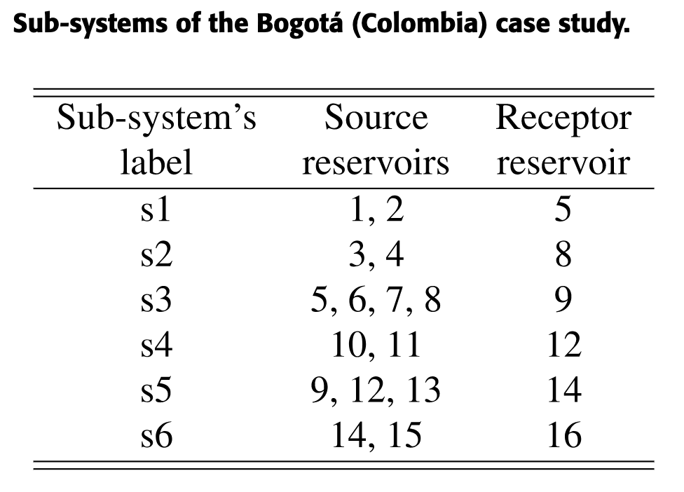
G.Obando, NQS, C.Ocampo-Martinez, Decentralized Control for Urban Drainage Systems using Replicator Dynamics. IEEE Acces, 2022.
Notes:
To simplify the illustration, we have simulated one portion of this stormwater UDS. Figure shows the structure of this UDS, which has 16 reservoirs. The table shows what the sub-systems would be once we apply the algorithm presented before.

Slide 49
G.Obando, NQS, C.Ocampo-Martinez, Decentralized Control for Urban Drainage Systems using Replicator Dynamics. IEEE Acces, 2022.
Notes:
Figure shows the hydrographs that models these reproduce a heavy rains scenario. These hydrographs are based on real data taken from measurements in some places in Bogotá.
Hydrographs are Gaussian functions whose parameters lie in the following intervals: center is between 0.5–0.75 hours; width is between 0–0.5 hours; and amplitude is between 0–0.22 m3/s.

Slide 50
G.Obando, NQS, C.Ocampo-Martinez, Decentralized Control for Urban Drainage Systems using Replicator Dynamics. IEEE Acces, 2022.
Notes:
When there is no control, i.e., the valves are open, for 3 and half hours. Throughout the simulation, wastewater only ﬁlls half of most reservoirs. In contrast, reservoirs 12 and 14 are overloaded during the ﬁrst half of the simulation. Indeed, the remaining capacity of reservoir 14 is negative during this ﬁrst half implying that ﬂooding occurs. The total ﬂooding is around 797.1 m3

Slide 51
G.Obando, NQS, C.Ocampo-Martinez, Decentralized Control for Urban Drainage Systems using Replicator Dynamics. IEEE Acces, 2022.
Notes:
when using the local controllers based on replicator dynamics, the total capacity of the UDS is better used because wastewater is stored in underloaded reservoirs. On the other hand, the total ﬂooding for the controlled case is 29.4 m3, which is only 4% of the ﬂooding that occurs for the uncontrolled case. Finally, contrary to what happens in the uncontrolled scenario where high ﬂooding is concentrated in reservoir 14, the controlled case shows that small ﬂoods occur in reservoirs 3, 4, 8 and 11.

Slide 52
G.Obando, NQS, C.Ocampo-Martinez, Decentralized Control for Urban Drainage Systems using Replicator Dynamics. IEEE Acces, 2022.
Notes:
The control inputs show that the opening percentage is never violated.

Slide 53
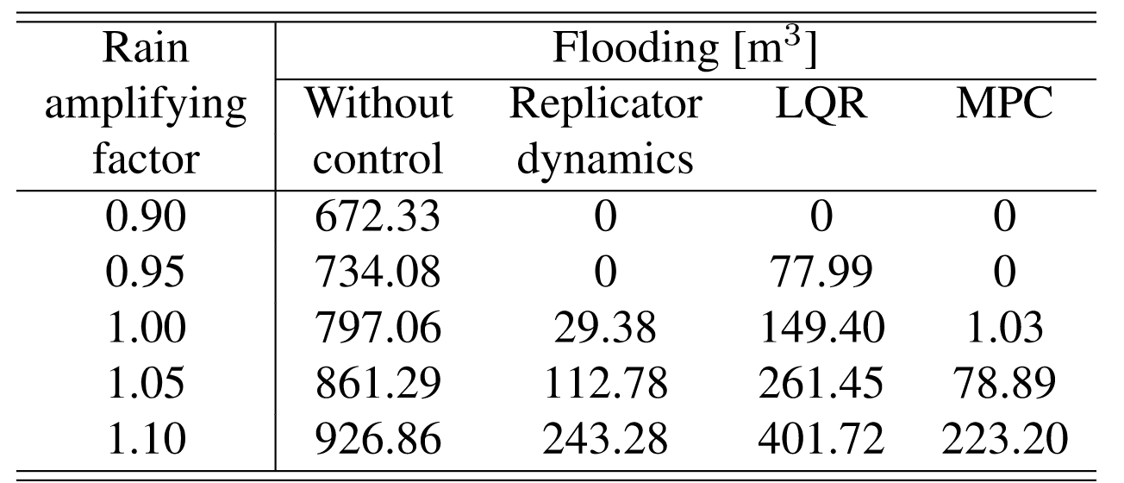
G.Obando, NQS, C.Ocampo-Martinez, Decentralized Control for Urban Drainage Systems using Replicator Dynamics. IEEE Acces, 2022.
Notes:
Some results are shown compared to some classical controllers. In this case, the MPC is designed as a centralized controller. We have also assumed that we can amplify/decrease the rain by a factor between +/- 10%.
The fact that LQR and replicator dynamics scale much better than MPC is a consequence of the decentralized nature of the ﬁrst two controllers, whose parallelization plays a key role (i.e., each UDS sub-system is capable of computing its own control inputs independently). In addition, another factor that makes replicator dynamics beat the two optimization-based methods in terms of scalability is the different paradigm that replicator dynamics use to update the control inputs. Speciﬁcally, when the UDS scale increases, optimization-based controllers require to solve minimization problems with a larger number of decision variables (under this situation, centralized MPC is highly penalized because it must deal with all decision variables of the whole UDS). On the contrary, replicator dynamics only need the evaluation of more algebraic equations to update the control input. As explained before, this evaluation requires signiﬁcantly lower computations than solving a constrained optimization problem.
\begin{table*}[h!]
\begin{center}
\begin{tabular}{c|ccccc}
\hline
\hline
& \multicolumn{5}{c}{Computational time [s]} \\
\cline{2-6}
Controller & \multicolumn{5}{c}{Case study}\\
& $r_{0.95}$ & $r_{1.00}$ & $r_{1.05}$ & $r_{1.10}$ & Average\\
\hline
Replicator dynamics & 2.01 & 2.07 & 2.06 & 2.15 & \bf{2.07}\\
LQR & 12.68 & 12.75 & 12.78 & 12.80 & \bf{12.75}\\
MPC & 248.36 & 252.21 & 255.78 & 257.83 & \bf{253.54}\\
\hline
\hline
\end{tabular}
\end{center}
\end{table*}
%

Slide 54
The great economic revolutions in history occur when new technologies converge with new energy systems
Jeremey Rifkin

Slide 55
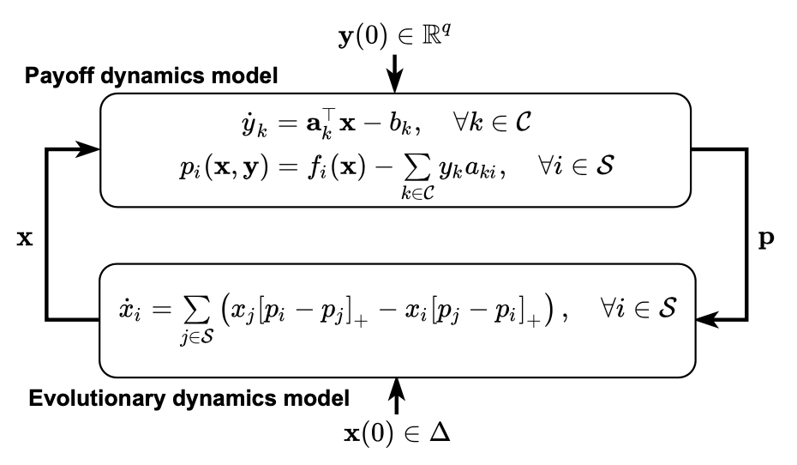
A Payoff Dynamics Model for Equality-Constrained Population Games
J.Martinez-Piazuelo, NQS, C.Ocampo-Martinez, A Payoff Dynamics Model for Equality-Constrained Population Games. IEEE Control Syst Lett, 6, 530–53, 2022.
Notes:
Now, I want to present a recent approach that we have started to work, where we change the PDM in order to be able to include equality constraints. This approach will help to consider other problems than the previous approach, as I will try to show next.

Slide 56
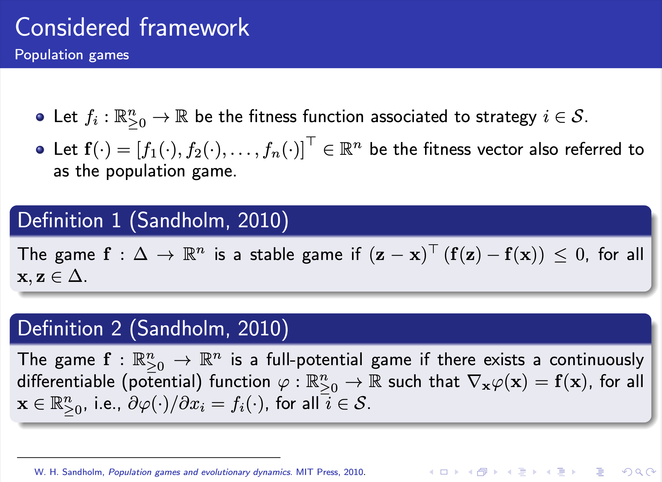
Notes:
Recall our considered framework. Depending on the form of f, different classes of games can be considered. One important class is a stable game. In this case, we should satisfy the monotonicity condition for all x and z in Delta.
Another important class of population games is the one of full potential games.
If the game is both stable and full potential, then such a game is a full potential game with concave potential function varphi, which would be part of the problem that we will introduce next.

Slide 57
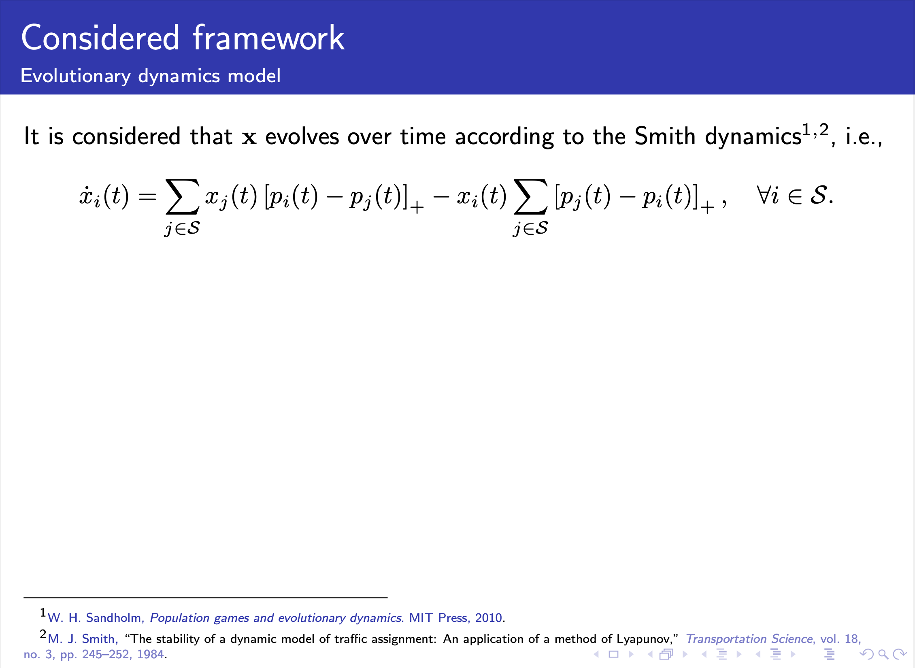
Notes:
We assume that the strategic distribution evolves according to the Smith dynamics, which were developed originally for traffic assignment. Regarding the payoff signals in the conventional framework, as we saw in the previous approach, the payoff is equal to the fitness. In this part of the talk, we left the payoffs be determined by an additional dynamical system, which will be introduced next.

Slide 58
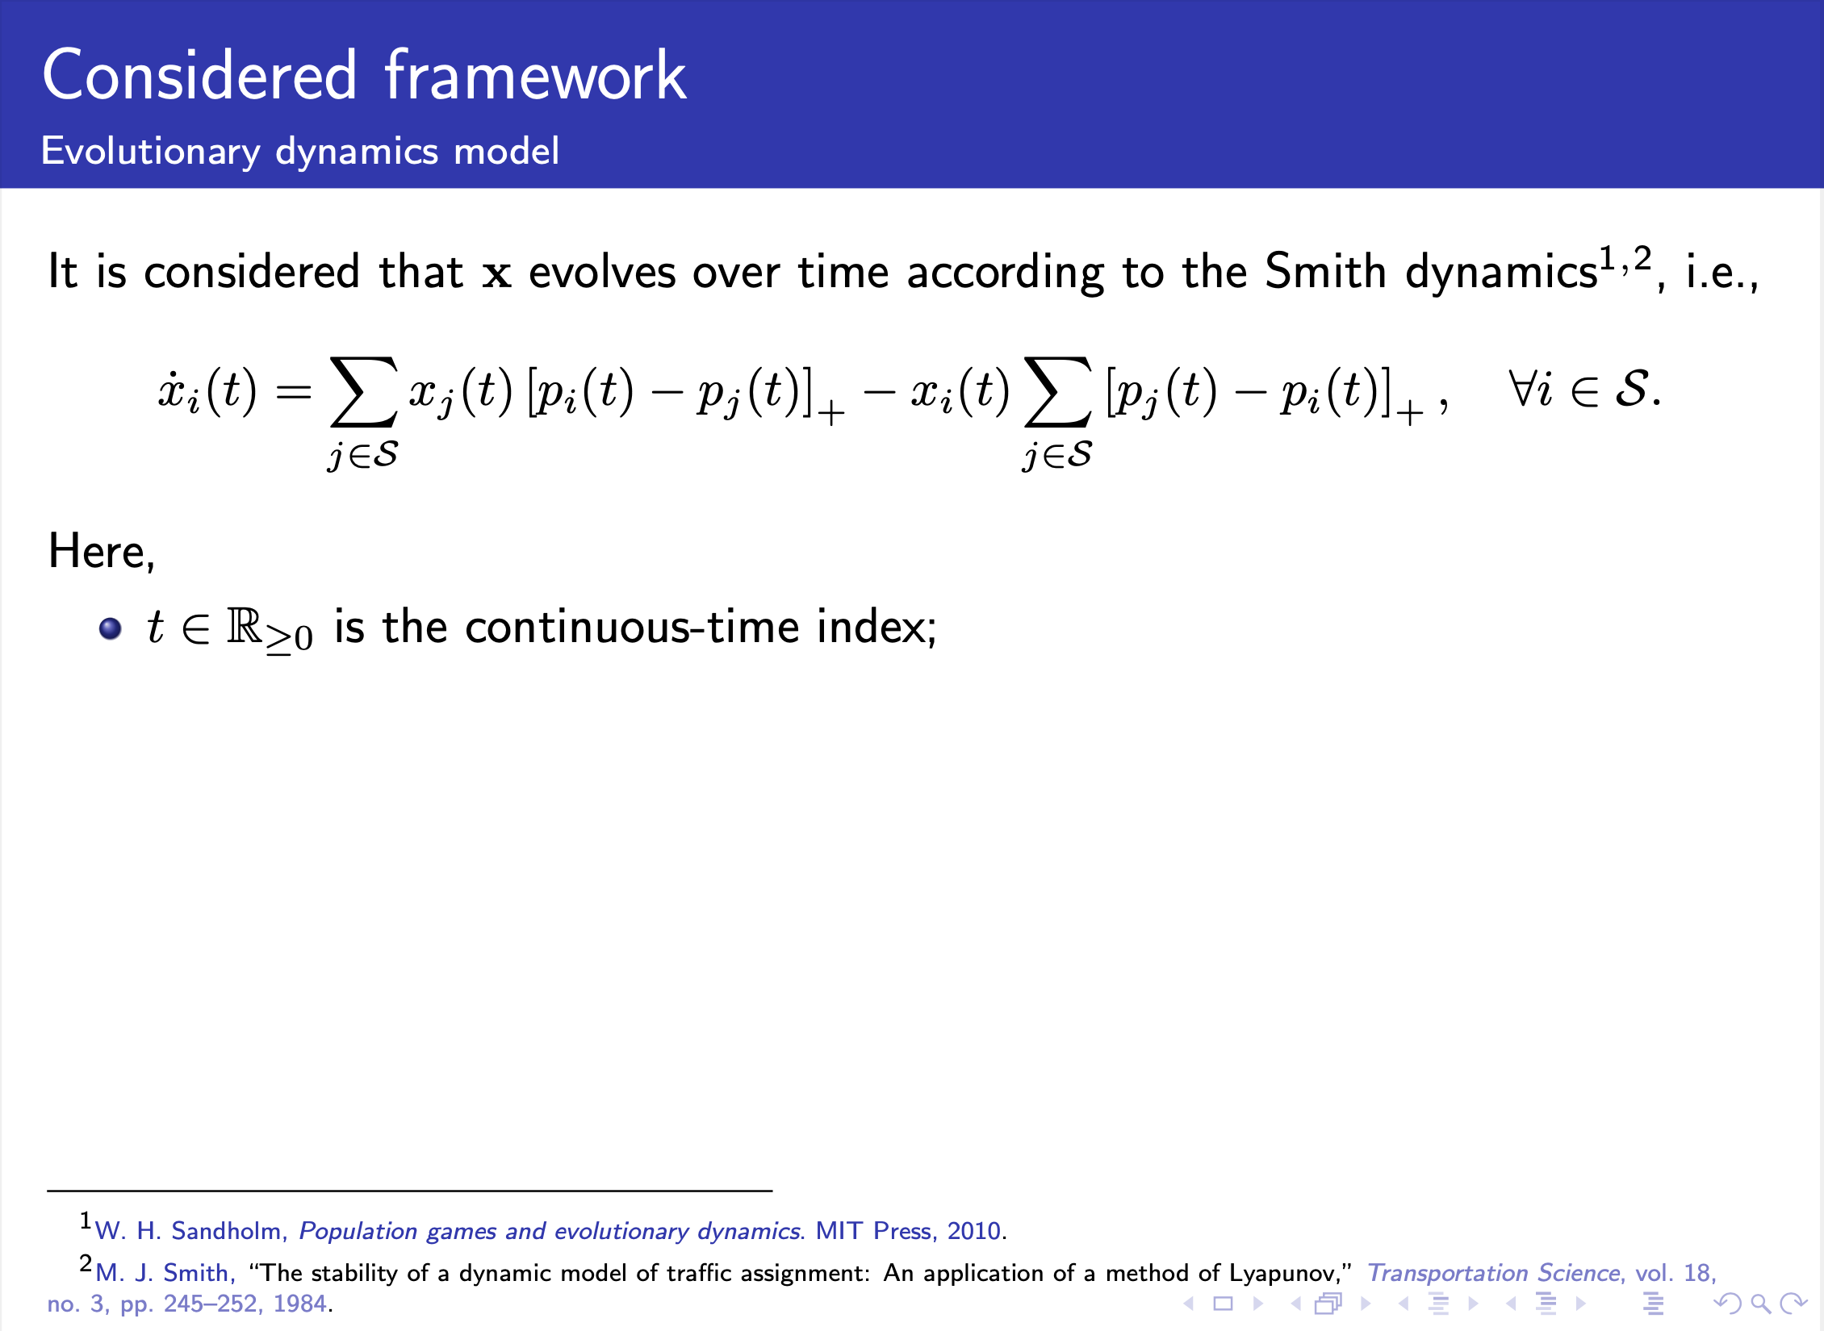
Notes:
We assume that the strategic distribution evolves according to the Smith dynamics, which were developed originally for traffic assignment. Regarding the payoff signals in the conventional framework, as we saw in the previous approach, the payoff is equal to the fitness. In this part of the talk, we left the payoffs be determined by an additional dynamical system, which will be introduced next.

Slide 59
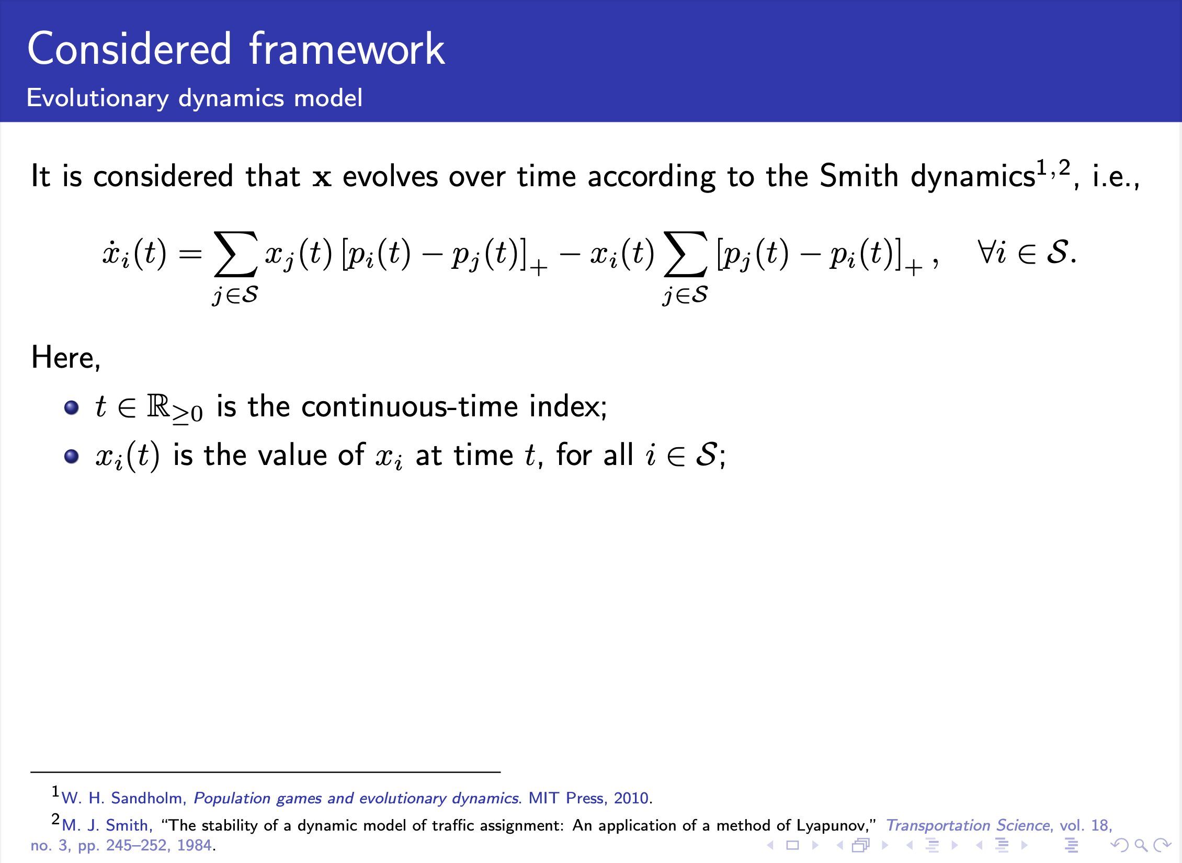
Notes:
We assume that the strategic distribution evolves according to the Smith dynamics, which were developed originally for traffic assignment. Regarding the payoff signals in the conventional framework, as we saw in the previous approach, the payoff is equal to the fitness. In this part of the talk, we left the payoffs be determined by an additional dynamical system, which will be introduced next.

Slide 60
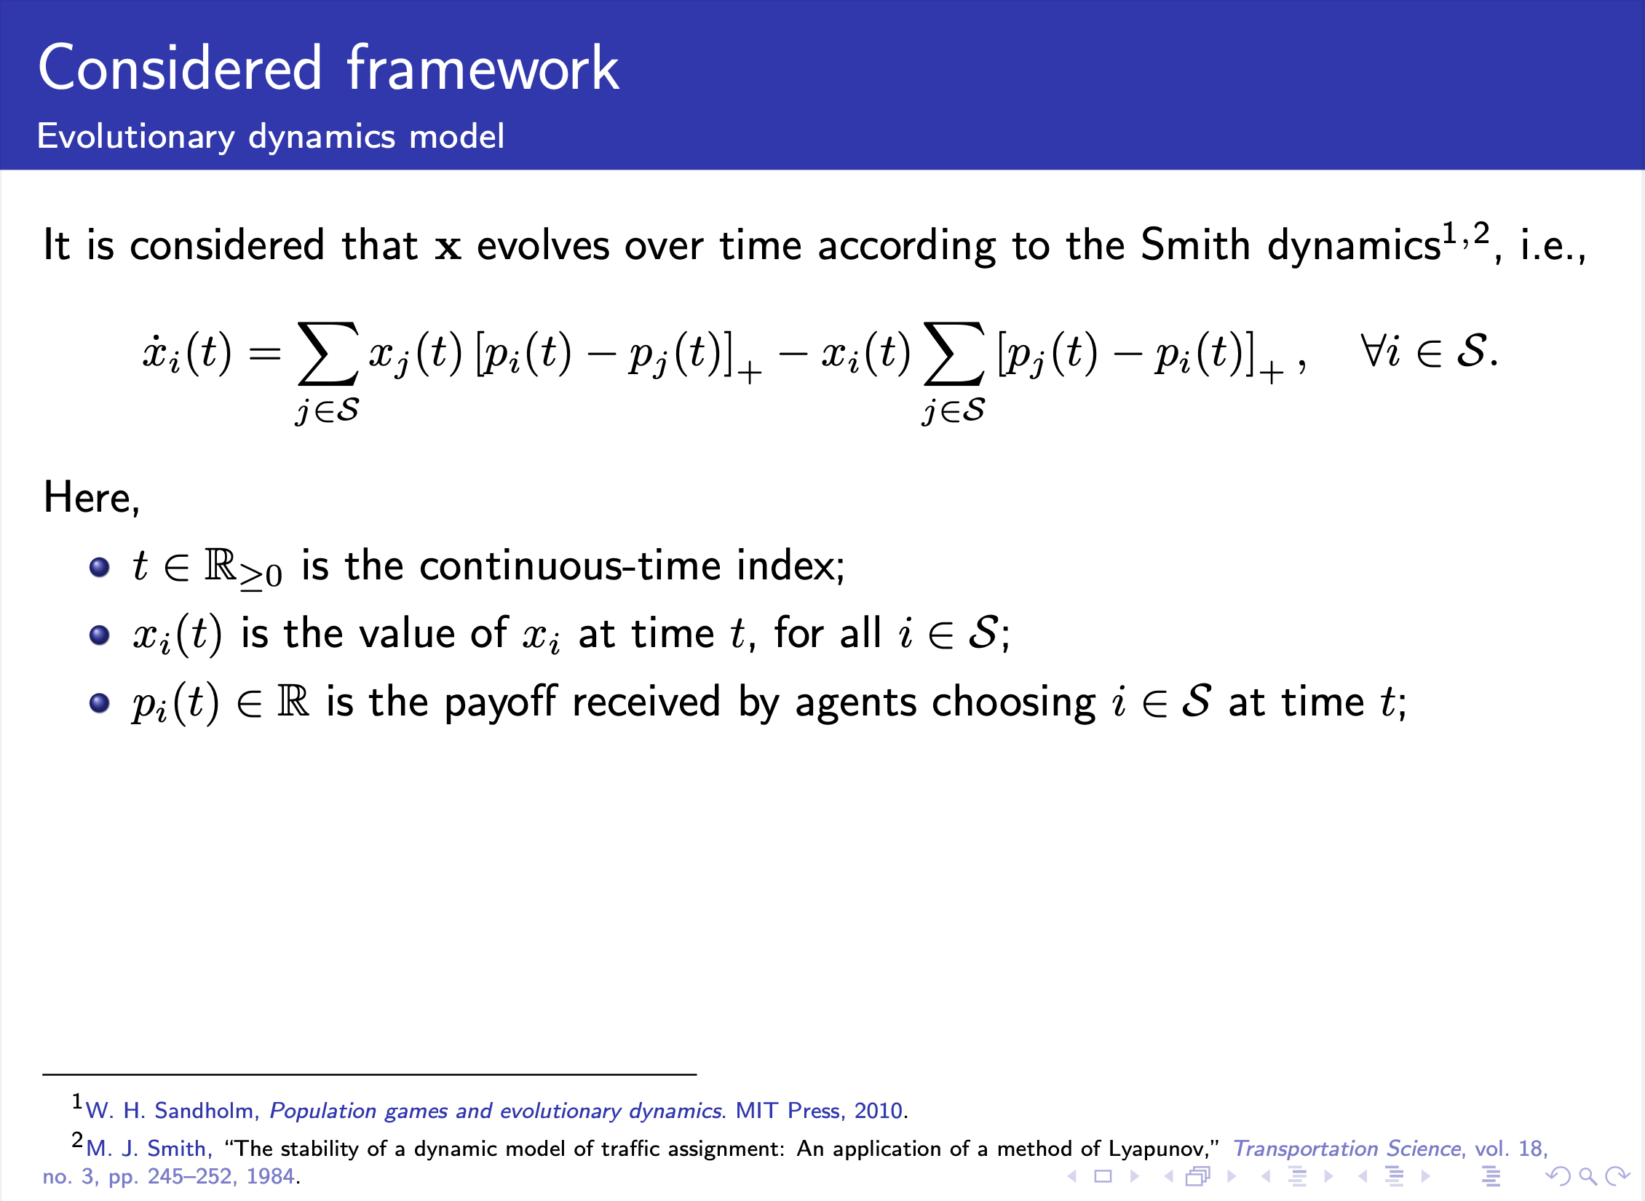
Notes:
We assume that the strategic distribution evolves according to the Smith dynamics, which were developed originally for traffic assignment. Regarding the payoff signals in the conventional framework, as we saw in the previous approach, the payoff is equal to the fitness. In this part of the talk, we left the payoffs be determined by an additional dynamical system, which will be introduced next.

Slide 61
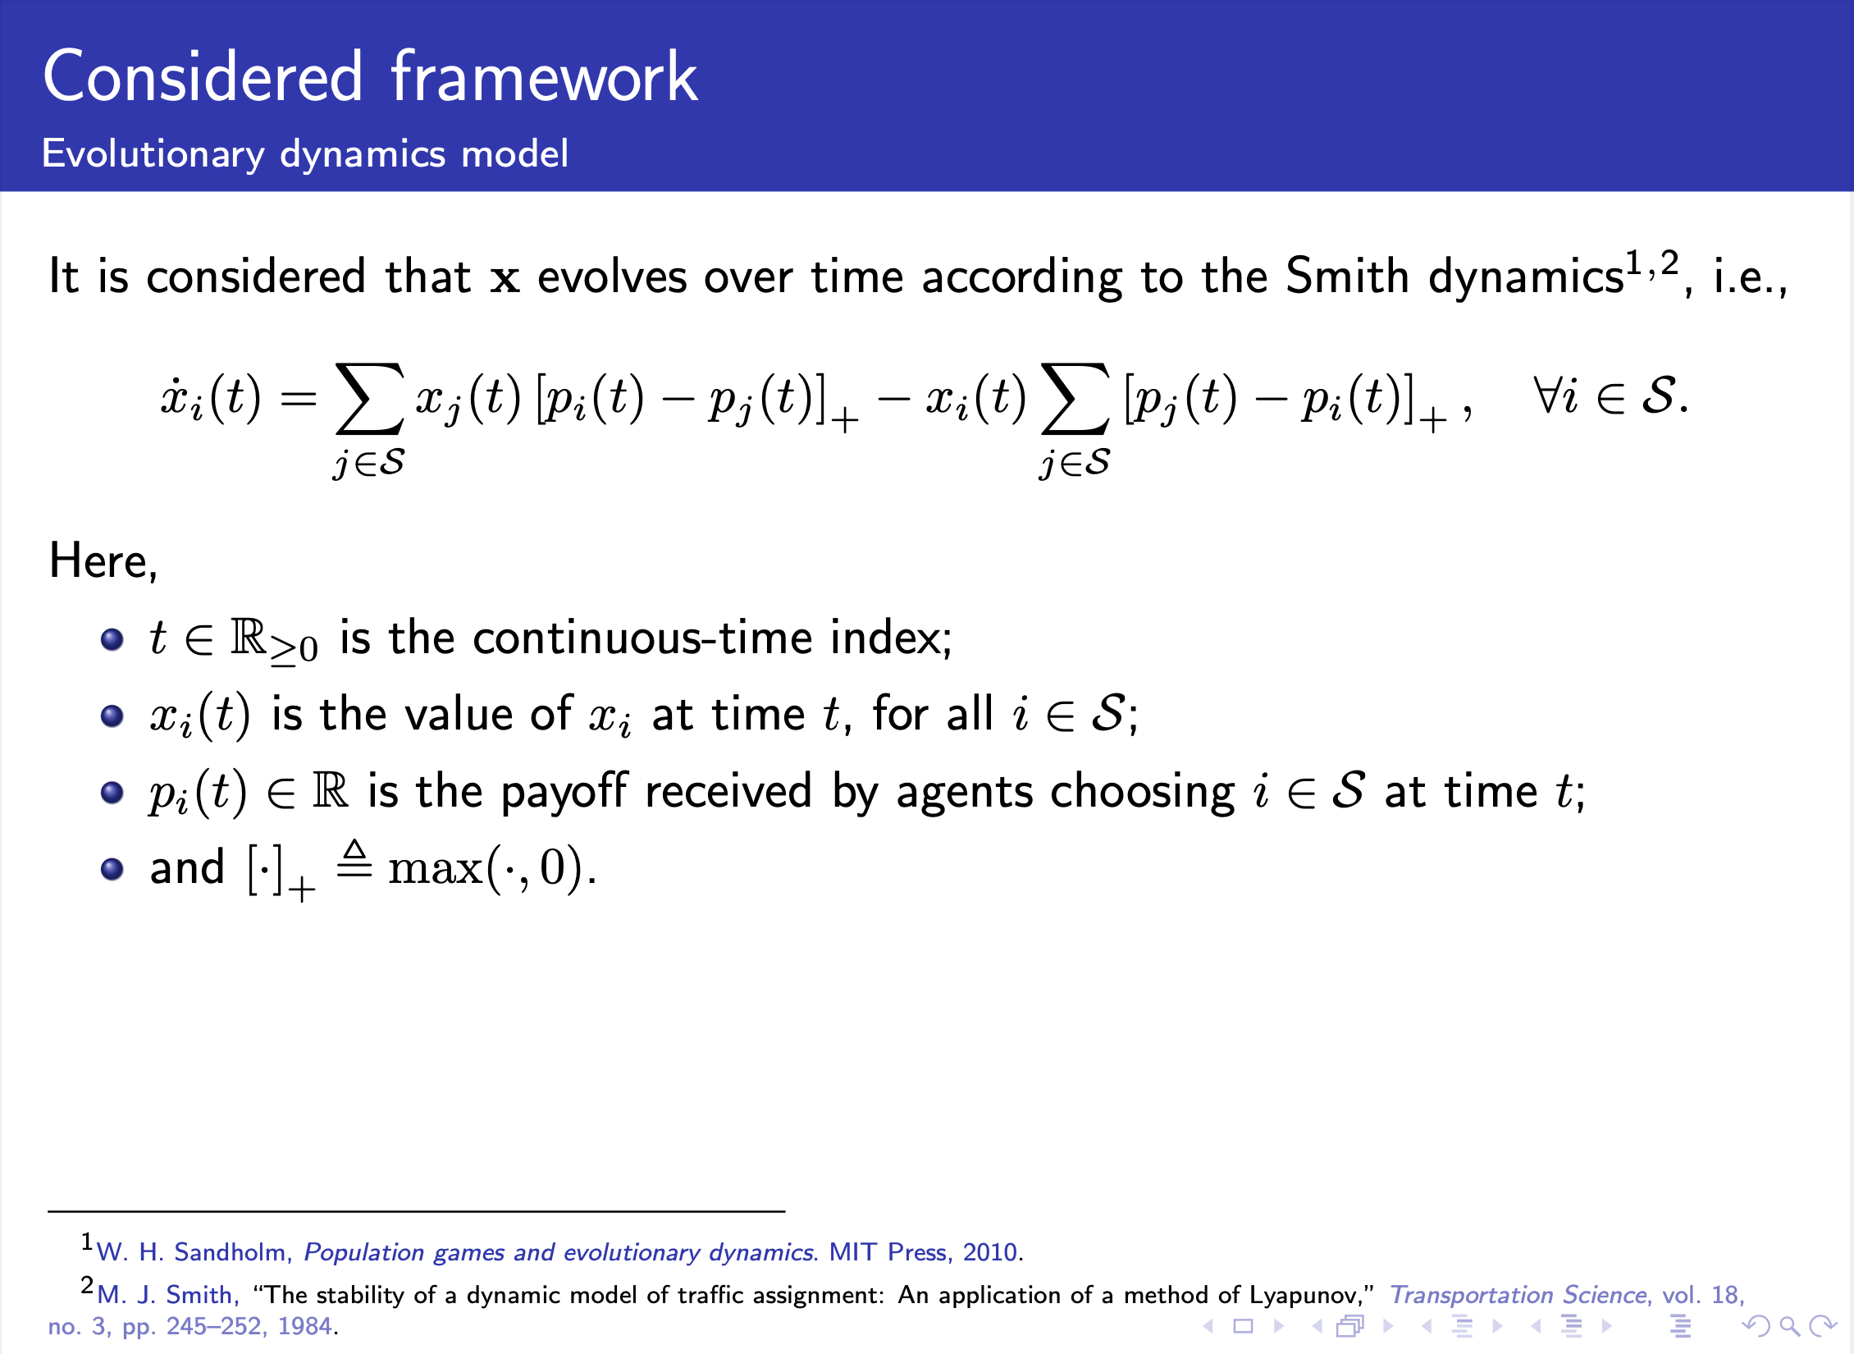
Notes:
We assume that the strategic distribution evolves according to the Smith dynamics, which were developed originally for traffic assignment. Regarding the payoff signals in the conventional framework, as we saw in the previous approach, the payoff is equal to the fitness. In this part of the talk, we left the payoffs be determined by an additional dynamical system, which will be introduced next.

Slide 62
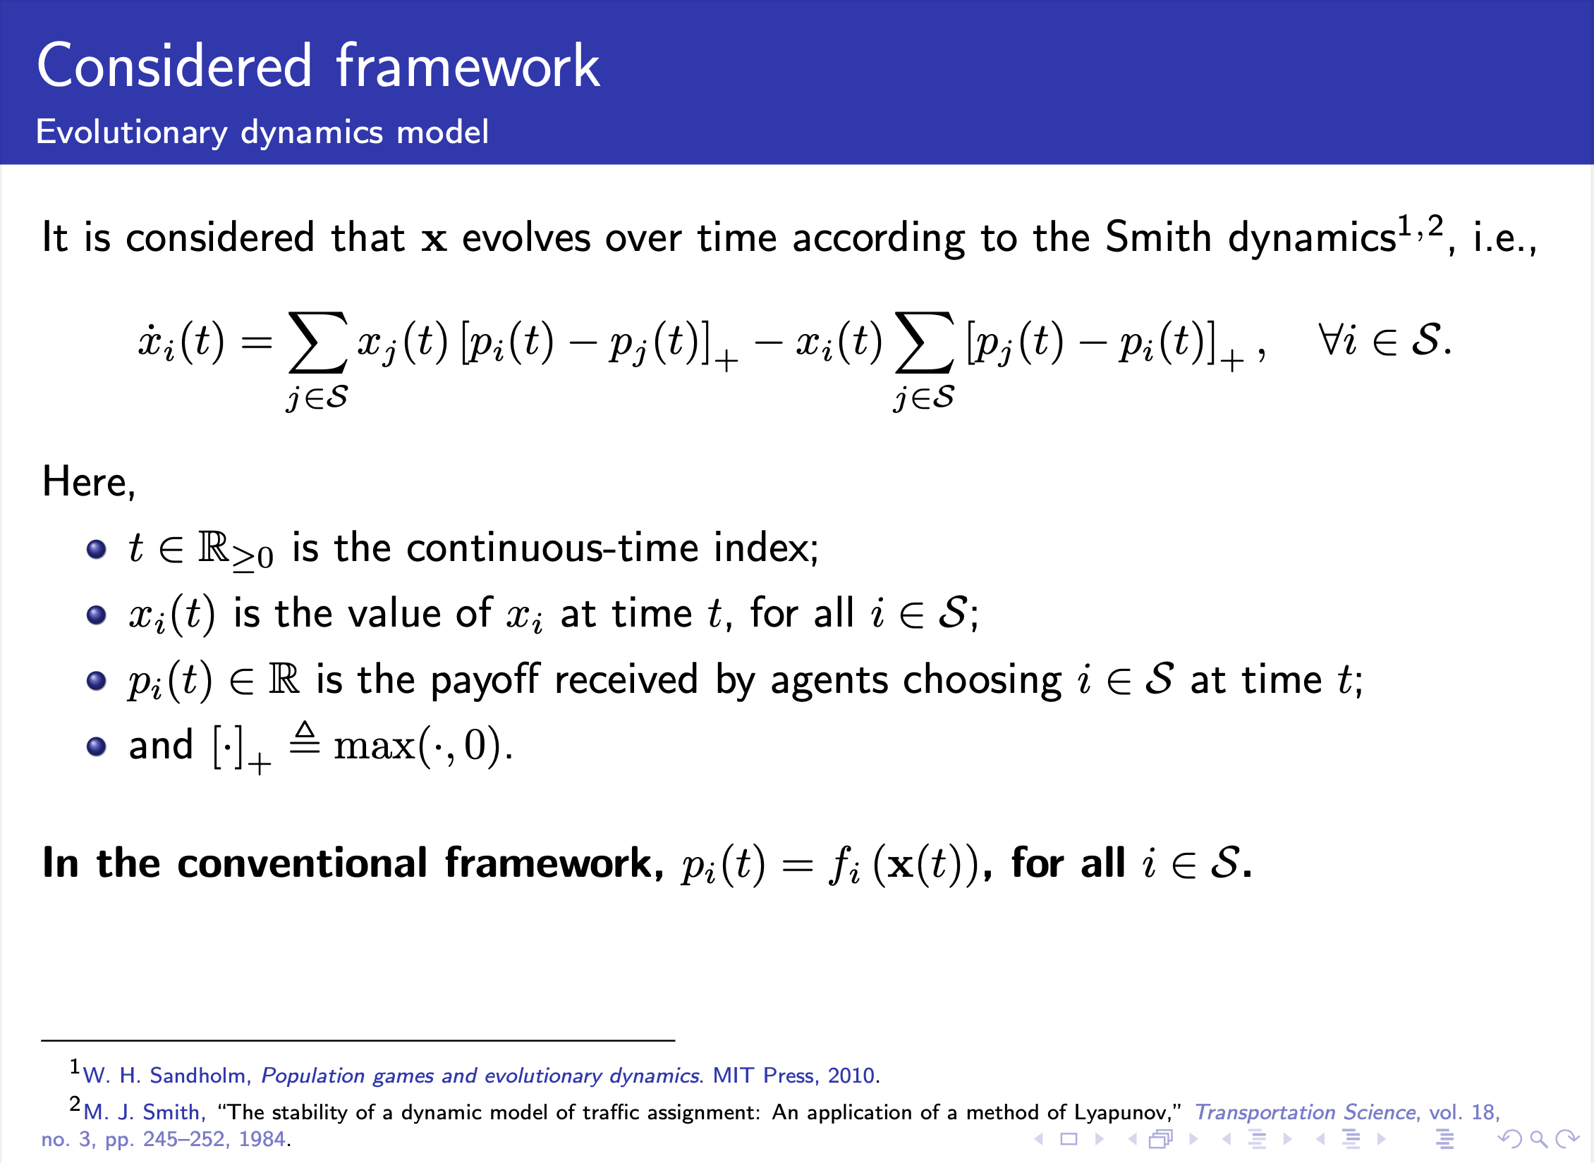
Notes:
We assume that the strategic distribution evolves according to the Smith dynamics, which were developed originally for traffic assignment. Regarding the payoff signals in the conventional framework, as we saw in the previous approach, the payoff is equal to the fitness. In this part of the talk, we left the payoffs be determined by an additional dynamical system, which will be introduced next.

Slide 63
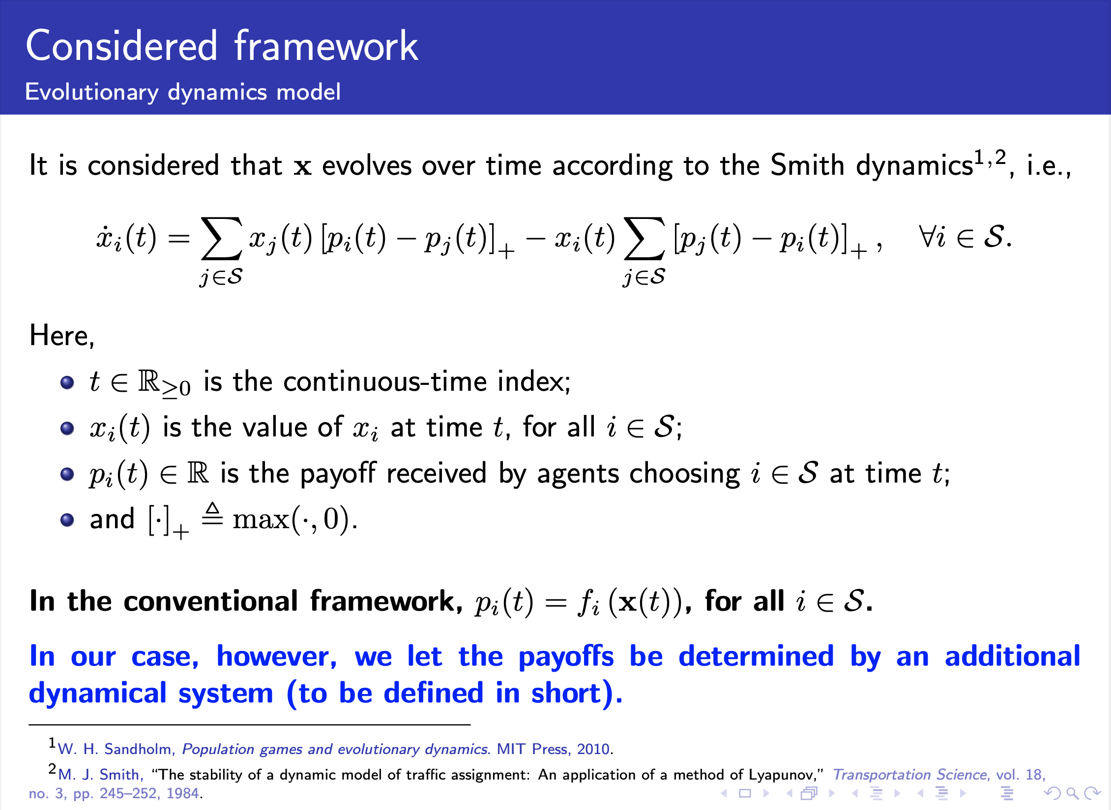
Notes:
We assume that the strategic distribution evolves according to the Smith dynamics, which were developed originally for traffic assignment. Regarding the payoff signals in the conventional framework, as we saw in the previous approach, the payoff is equal to the fitness. In this part of the talk, we left the payoffs be determined by an additional dynamical system, which will be introduced next.

Slide 64
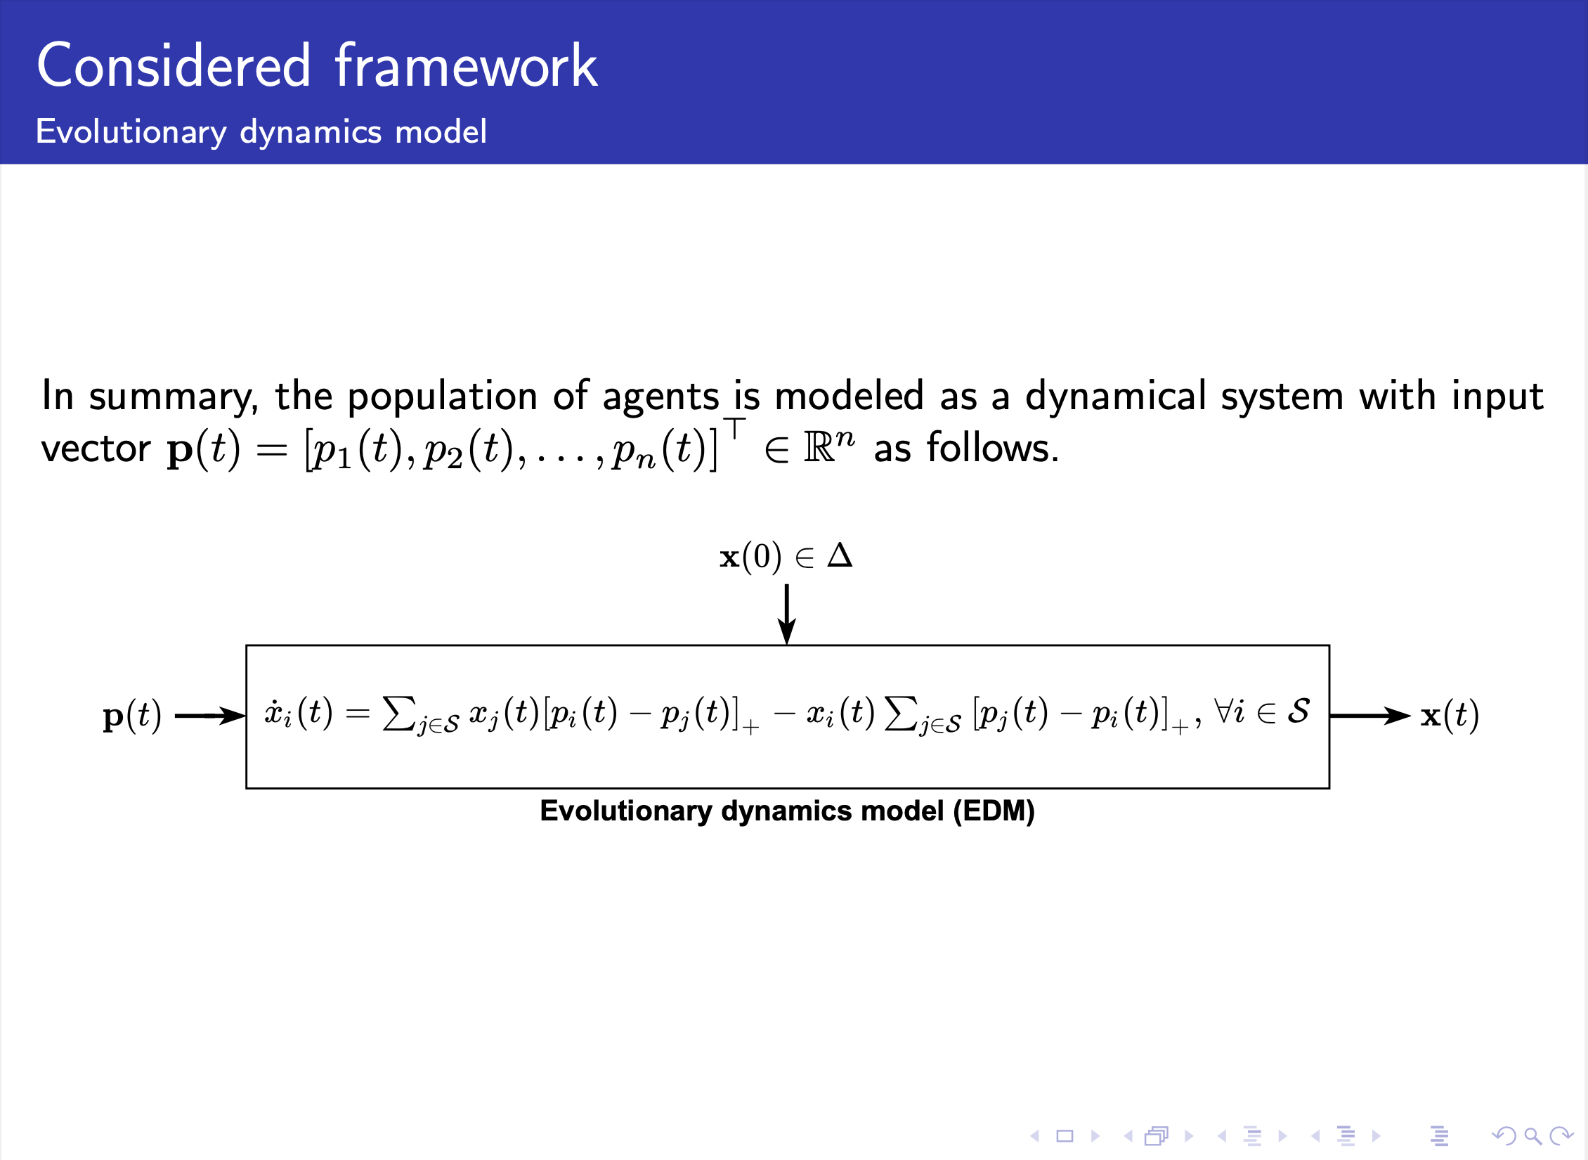
Notes:
Basically, the population of agents is modeled as a dynamical system with input the payoff vector p(t) as we can see in the figure.

Slide 65
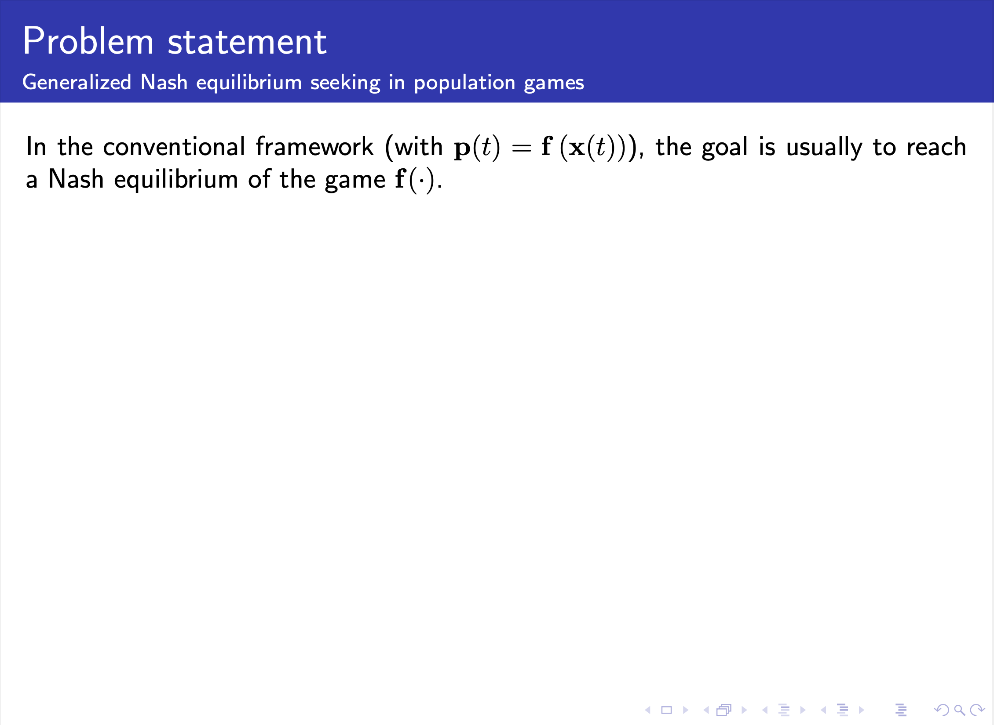
Notes:
In the conventional framework, the payoff and the fitness vectors are equal. In this case, the goal is usually to reach a Nash equilibrium of the game. The set of Nash equilibria is defined as follows. In other words, the definition says that at the equilibrium no agent can unilaterally deviate from the selected strategy and receive a higher payoff.

Slide 66
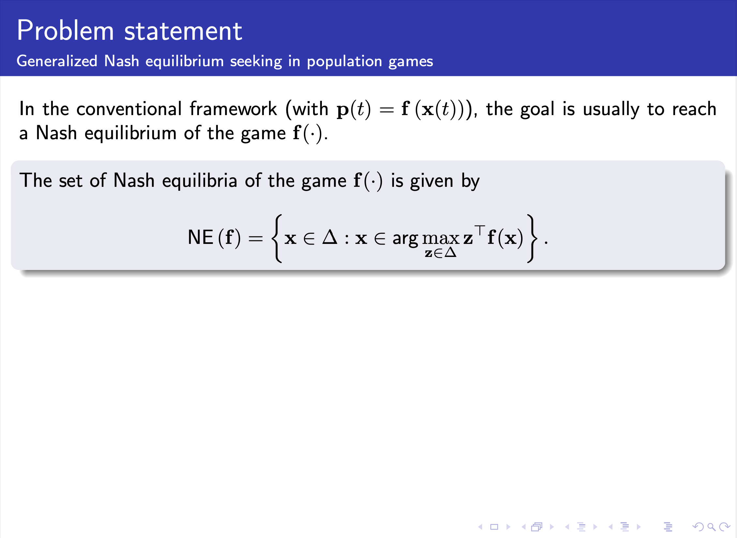
Notes:
In the conventional framework, the payoff and the fitness vectors are equal. In this case, the goal is usually to reach a Nash equilibrium of the game. The set of Nash equilibria is defined as follows. In other words, the definition says that at the equilibrium no agent can unilaterally deviate from the selected strategy and receive a higher payoff.

Slide 67
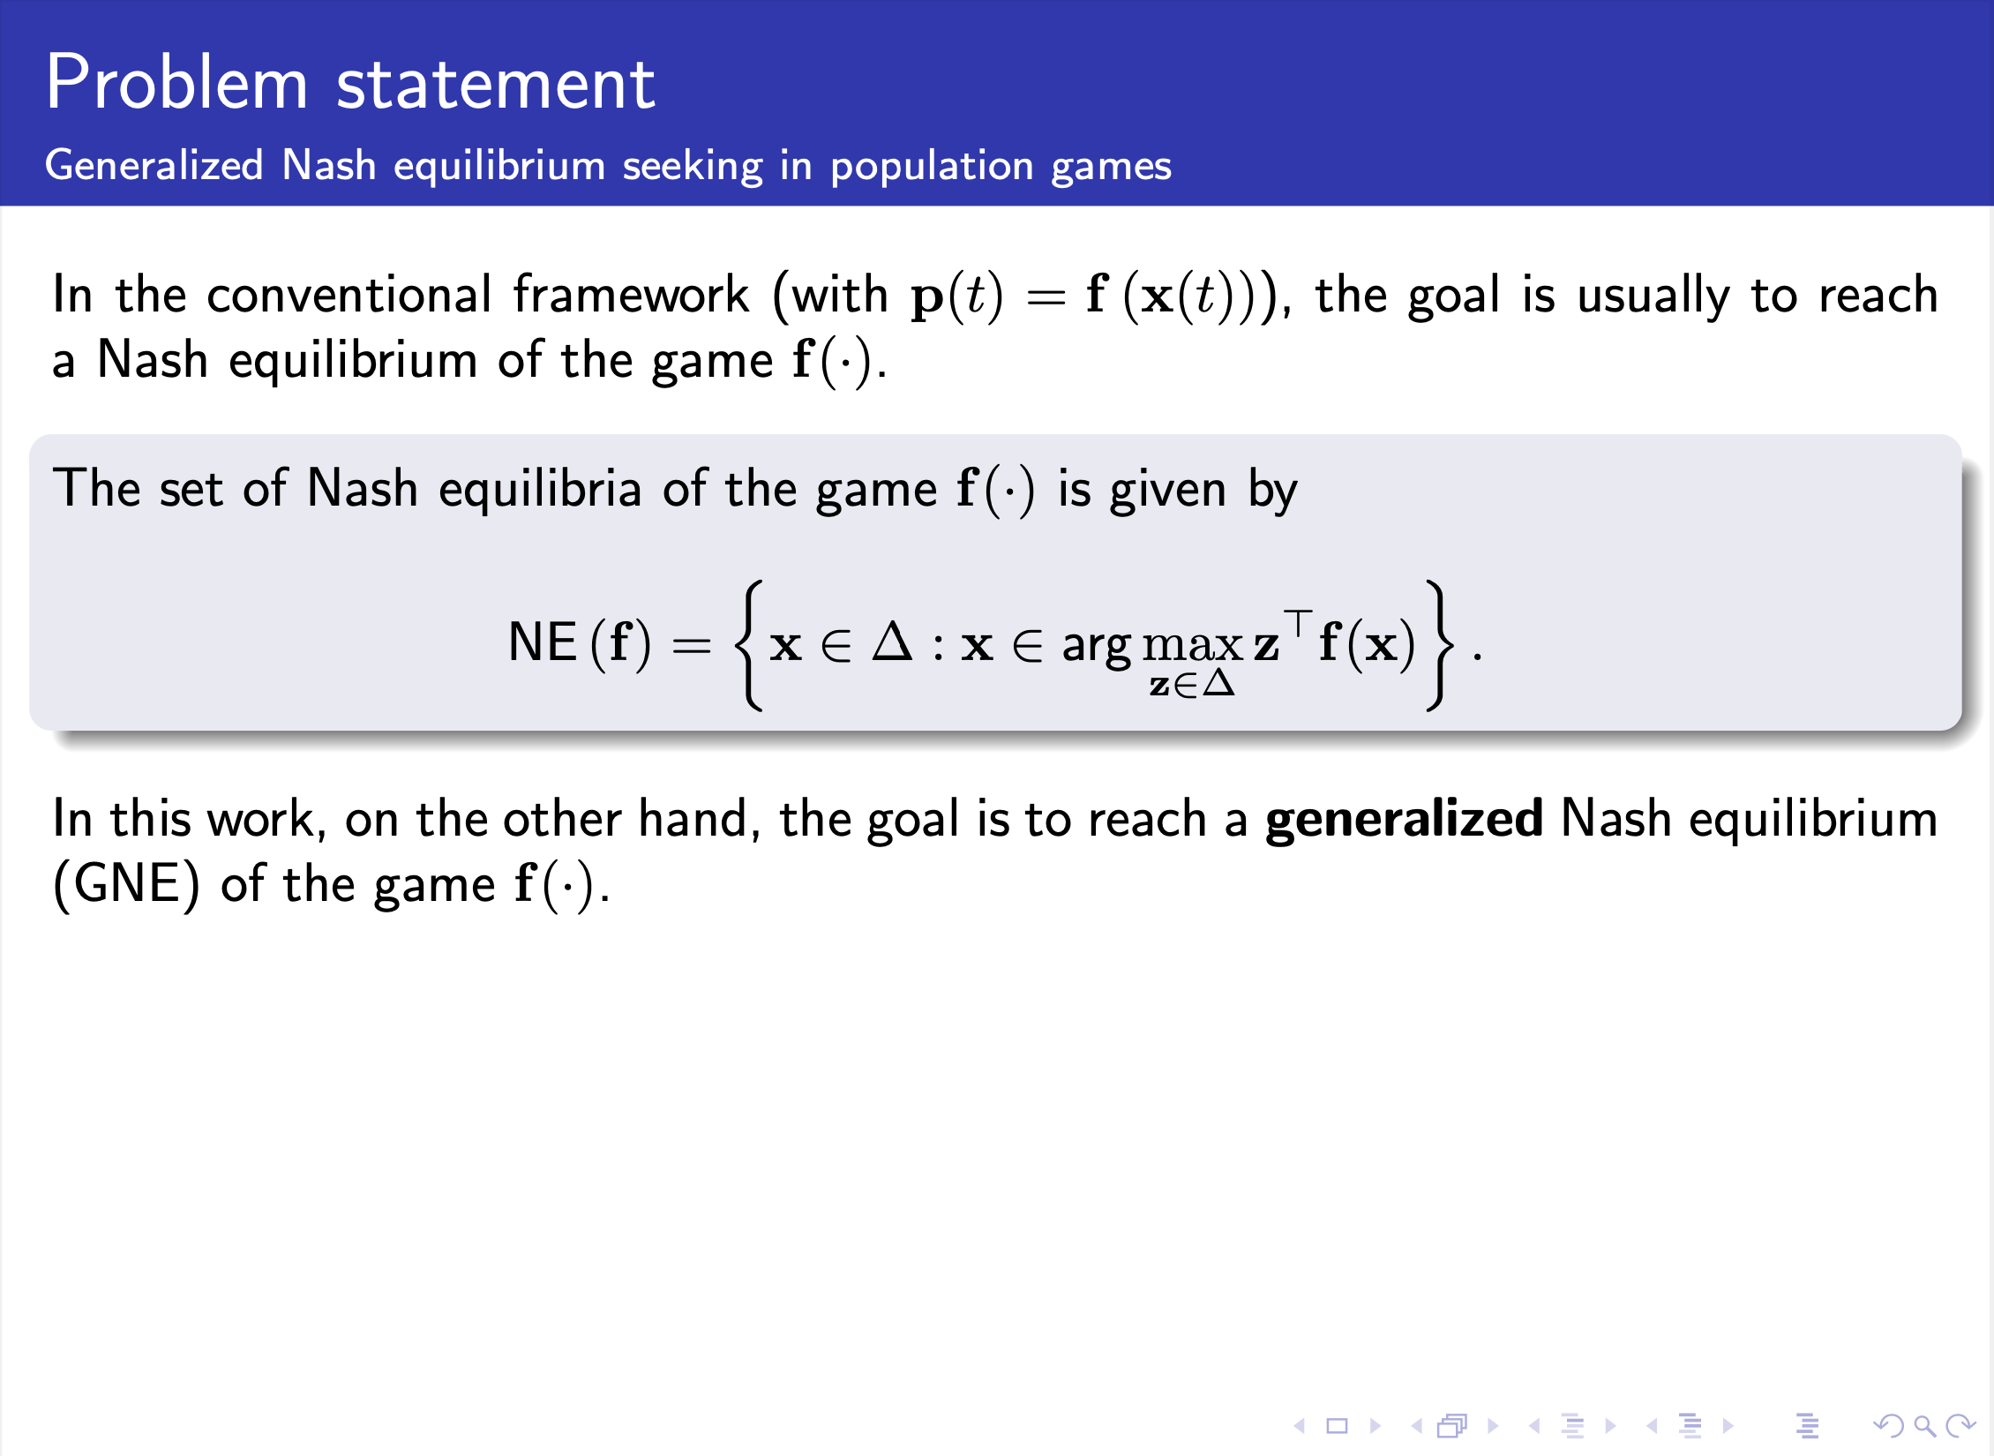
Notes:
In the conventional framework, the payoff and the fitness vectors are equal. In this case, the goal is usually to reach a Nash equilibrium of the game. The set of Nash equilibria is defined as follows. In other words, the definition says that at the equilibrium no agent can unilaterally deviate from the selected strategy and receive a higher payoff.

Slide 68
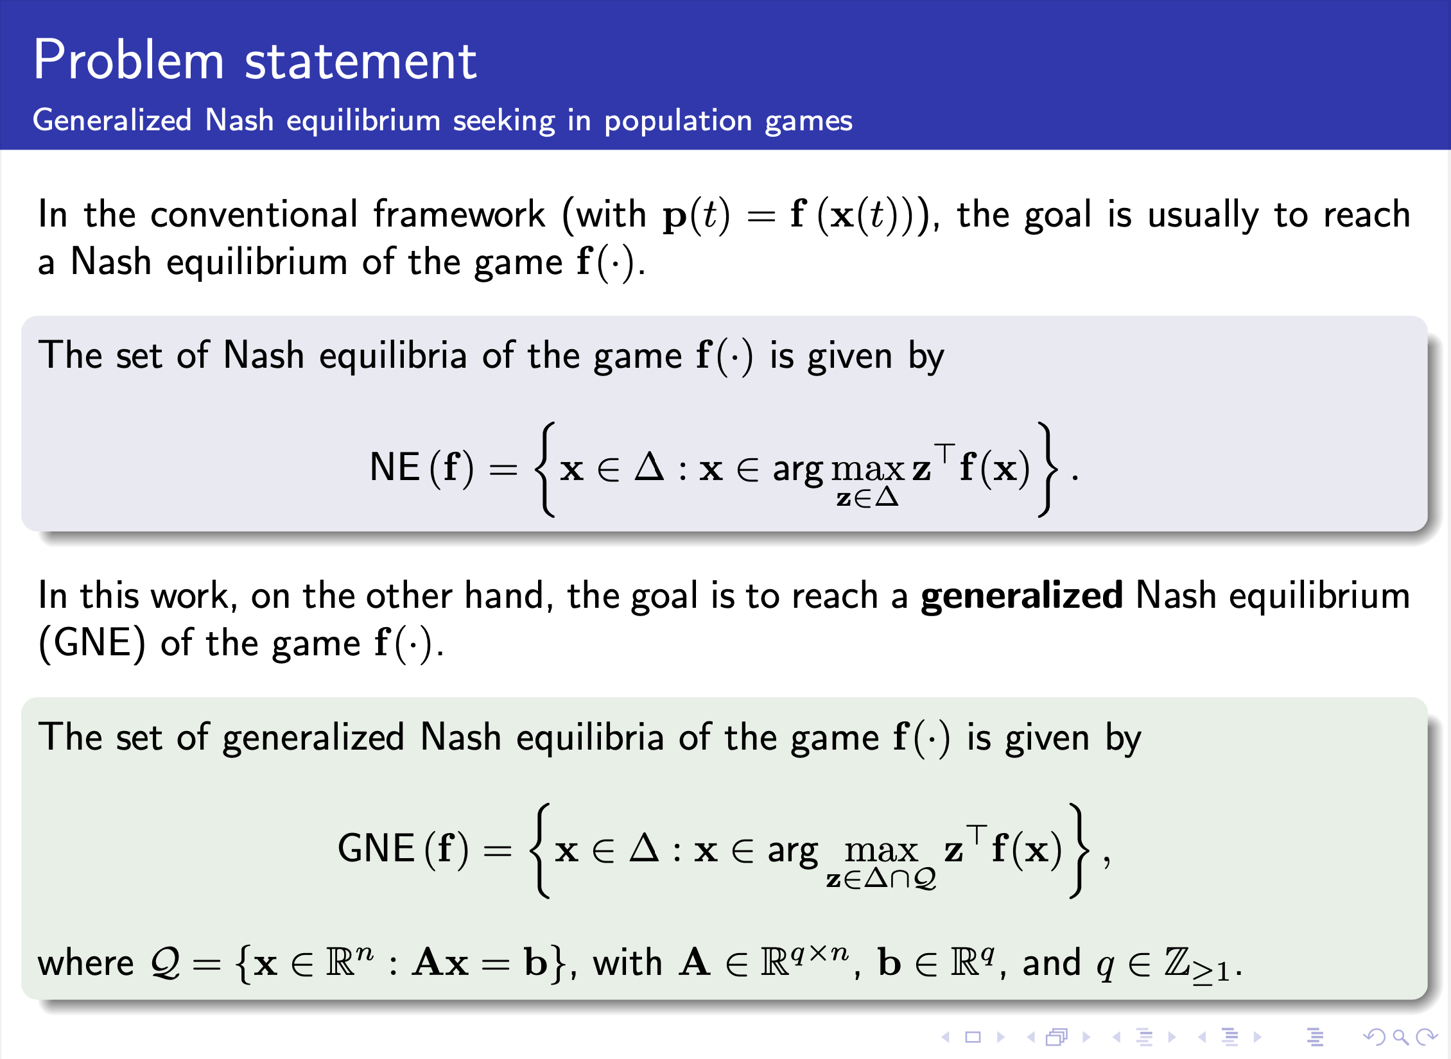
Notes:
In this work, the goal is to reach a generalized Nash equilibrium, which is defined in a similar way as before. However, we include some additional constraints that are affine equality constraints.

Slide 69
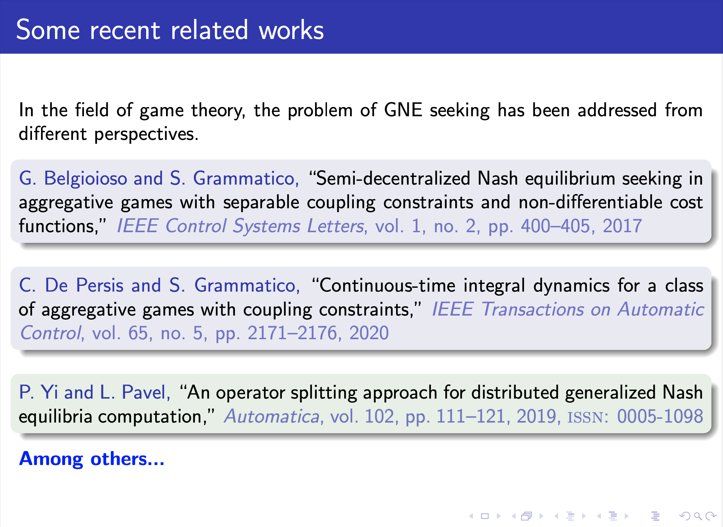
Notes:
Some works have addressed the GNE from different perspectives. There are problems in aggregative games such as the first two references, and the last one deals with monotone games with coupled constraints over the players’ decisions.

Slide 70
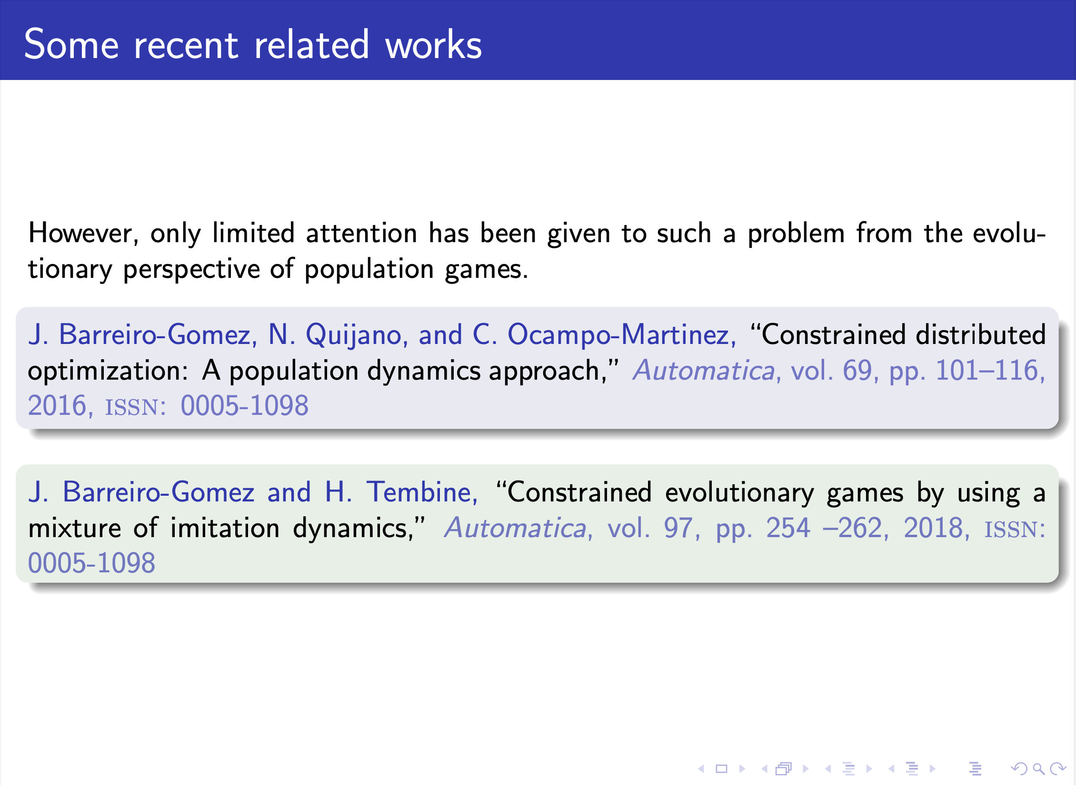
Notes:
In population games there has been a limited attention on the problem. GNE under affine constraints but under density dependent population games was addressed in the first work. These are population games, where the total mass of agents varies over time.
In the second work the total mass is constant, but the constraints are box constraints that are decoupled.
We seek to generalize these approaches by considering more general affine constraints.

Slide 71
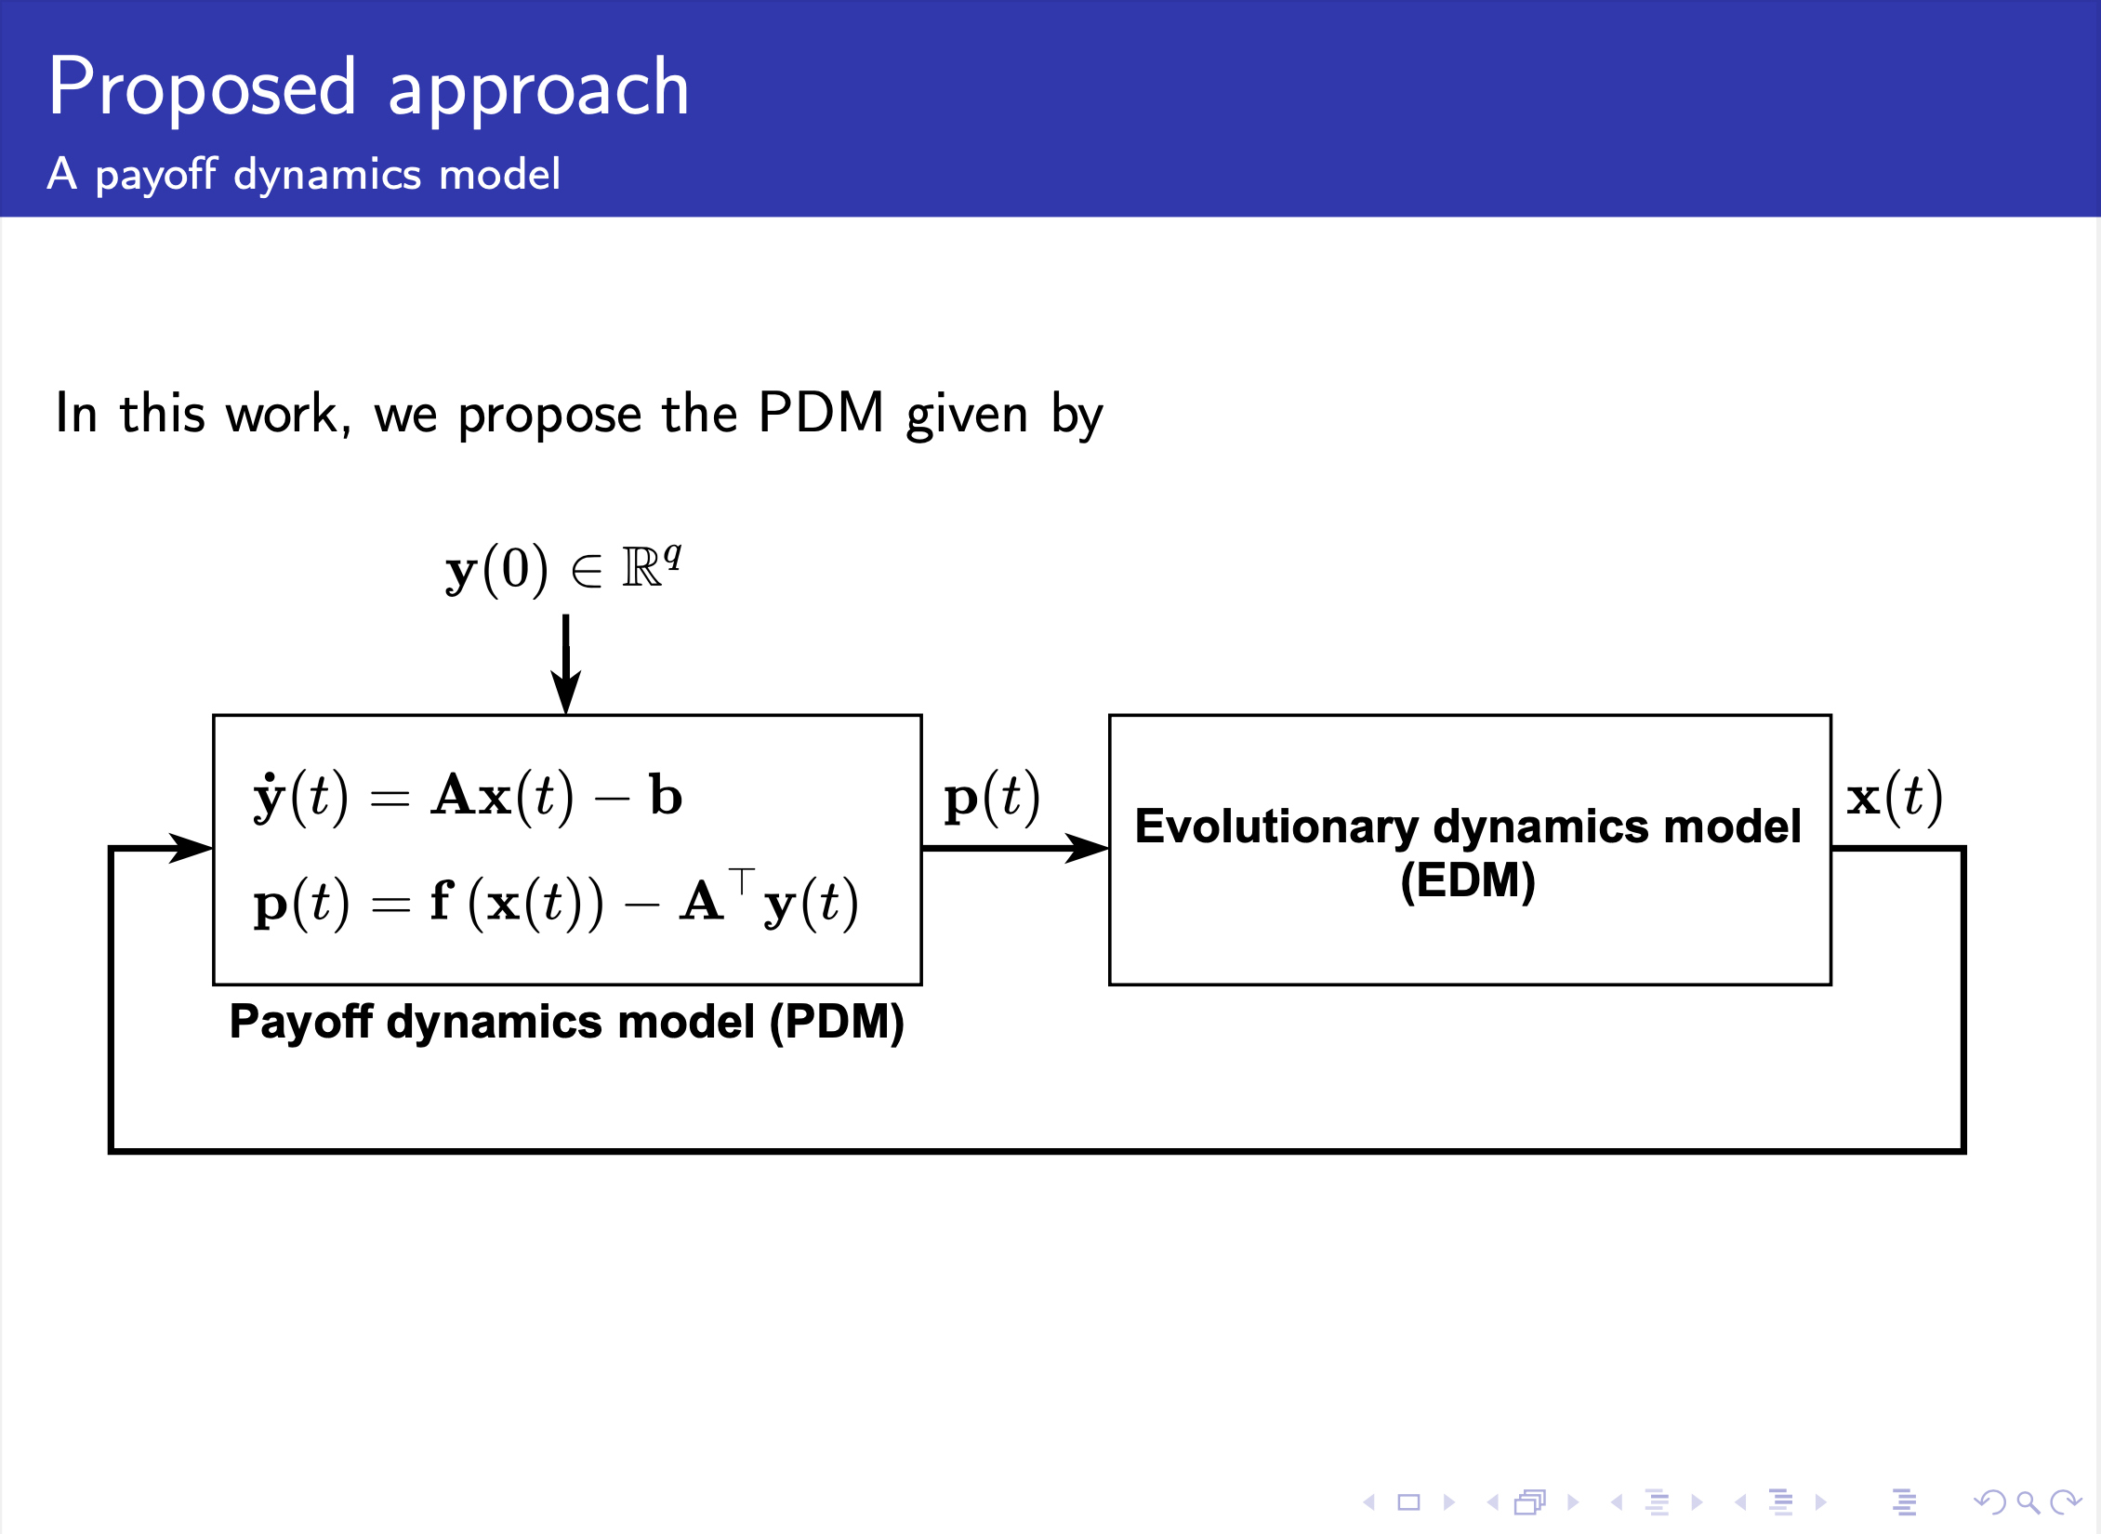
J.Martinez-Piazuelo, NQS, and C.Ocampo-Martinez, A Payoff Dynamics Model for Equality-Constrained Population Games, IEEE Control Systems Letters, 2022
Notes:
The payoff vector depends on the constraints considered and the fitness.
C = {1, 2, . . . , q} be the set of indices of the equality constraints,

Slide 72
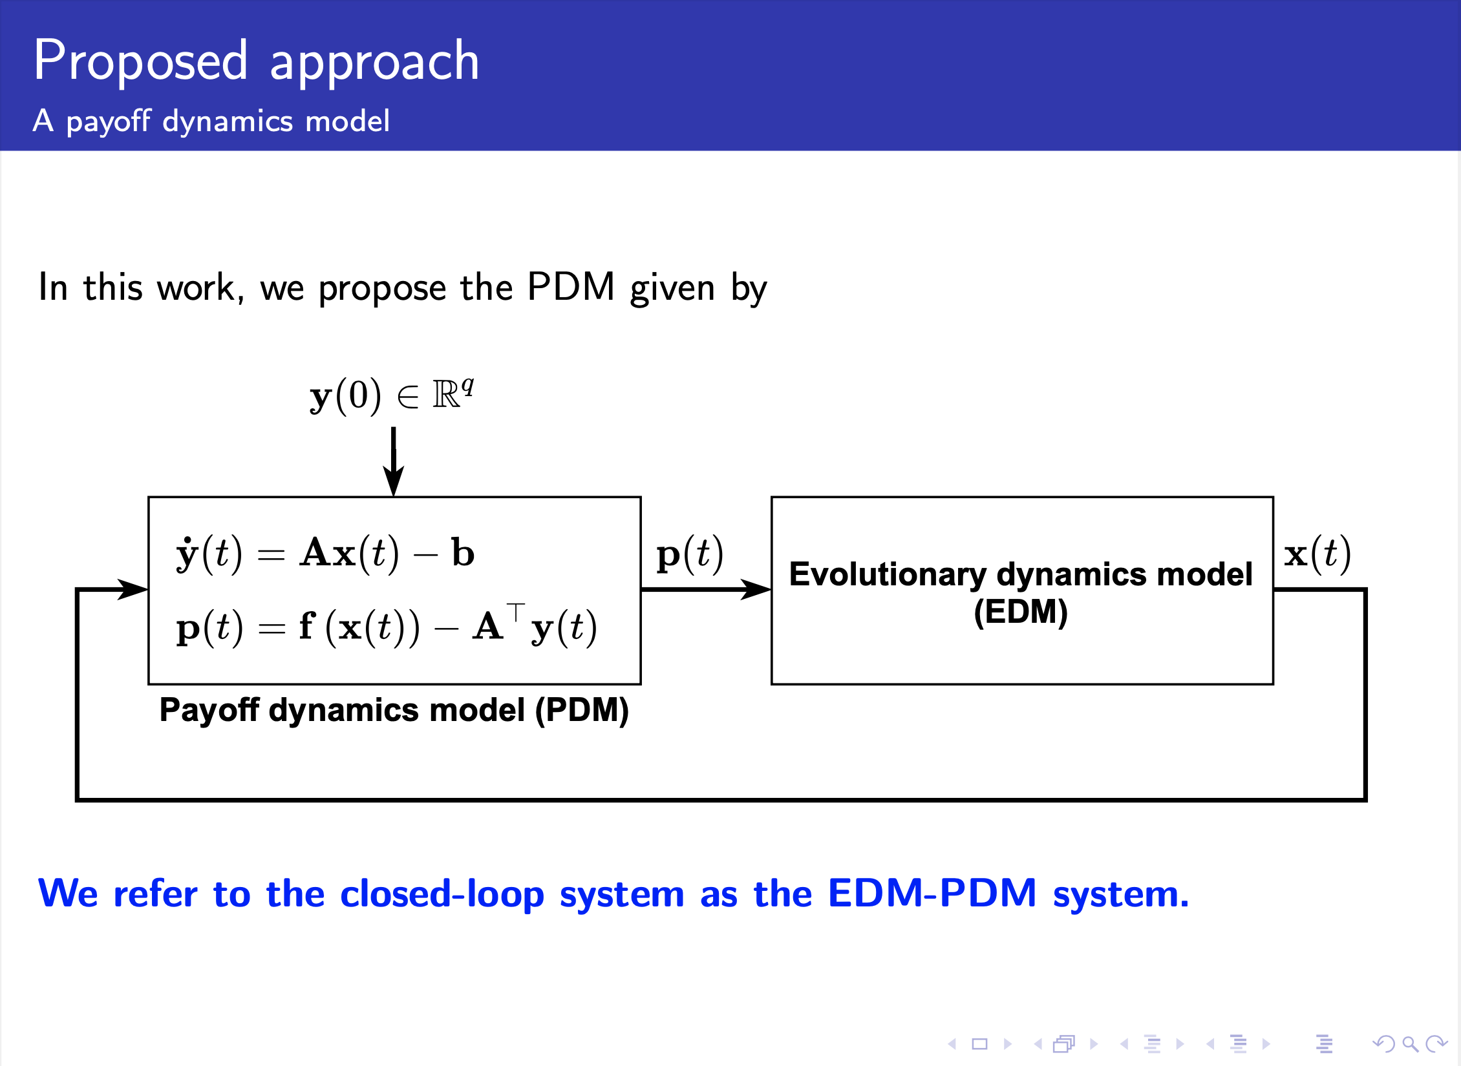
J.Martinez-Piazuelo, NQS, and C.Ocampo-Martinez, A Payoff Dynamics Model for Equality-Constrained Population Games, IEEE Control Systems Letters, 2022
Notes:
To sum up, the proposed approach consists on a closed-loop system, which is composed by the evolutionary dynamics model based on the Smith dynamics and the payoff dynamics model that includes the payoff vector associated to the fitness and the constraints of the problem.

Slide 73
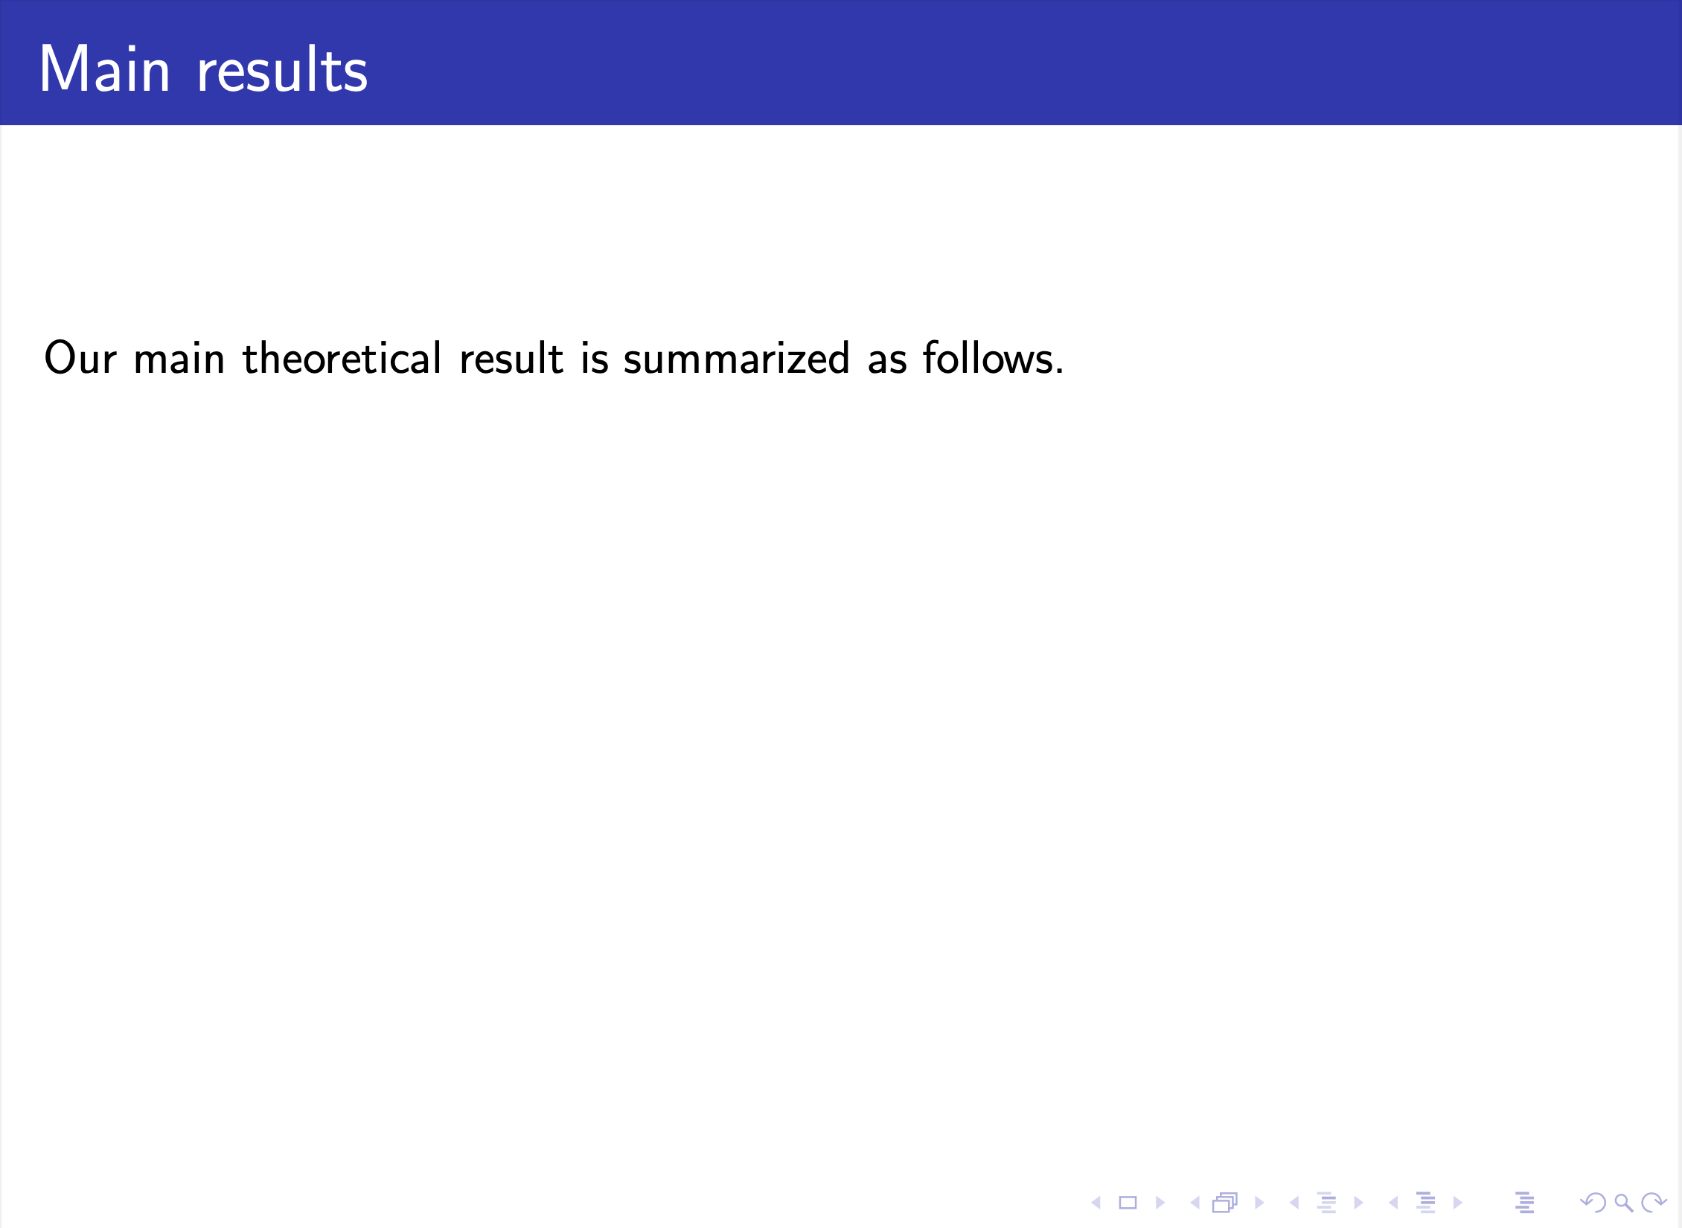
J.Martinez-Piazuelo, NQS, and C.Ocampo-Martinez, A Payoff Dynamics Model for Equality-Constrained Population Games, IEEE Control Systems Letters, 2022
Notes:
Our main theoretical result is summarized as follows….

Slide 74
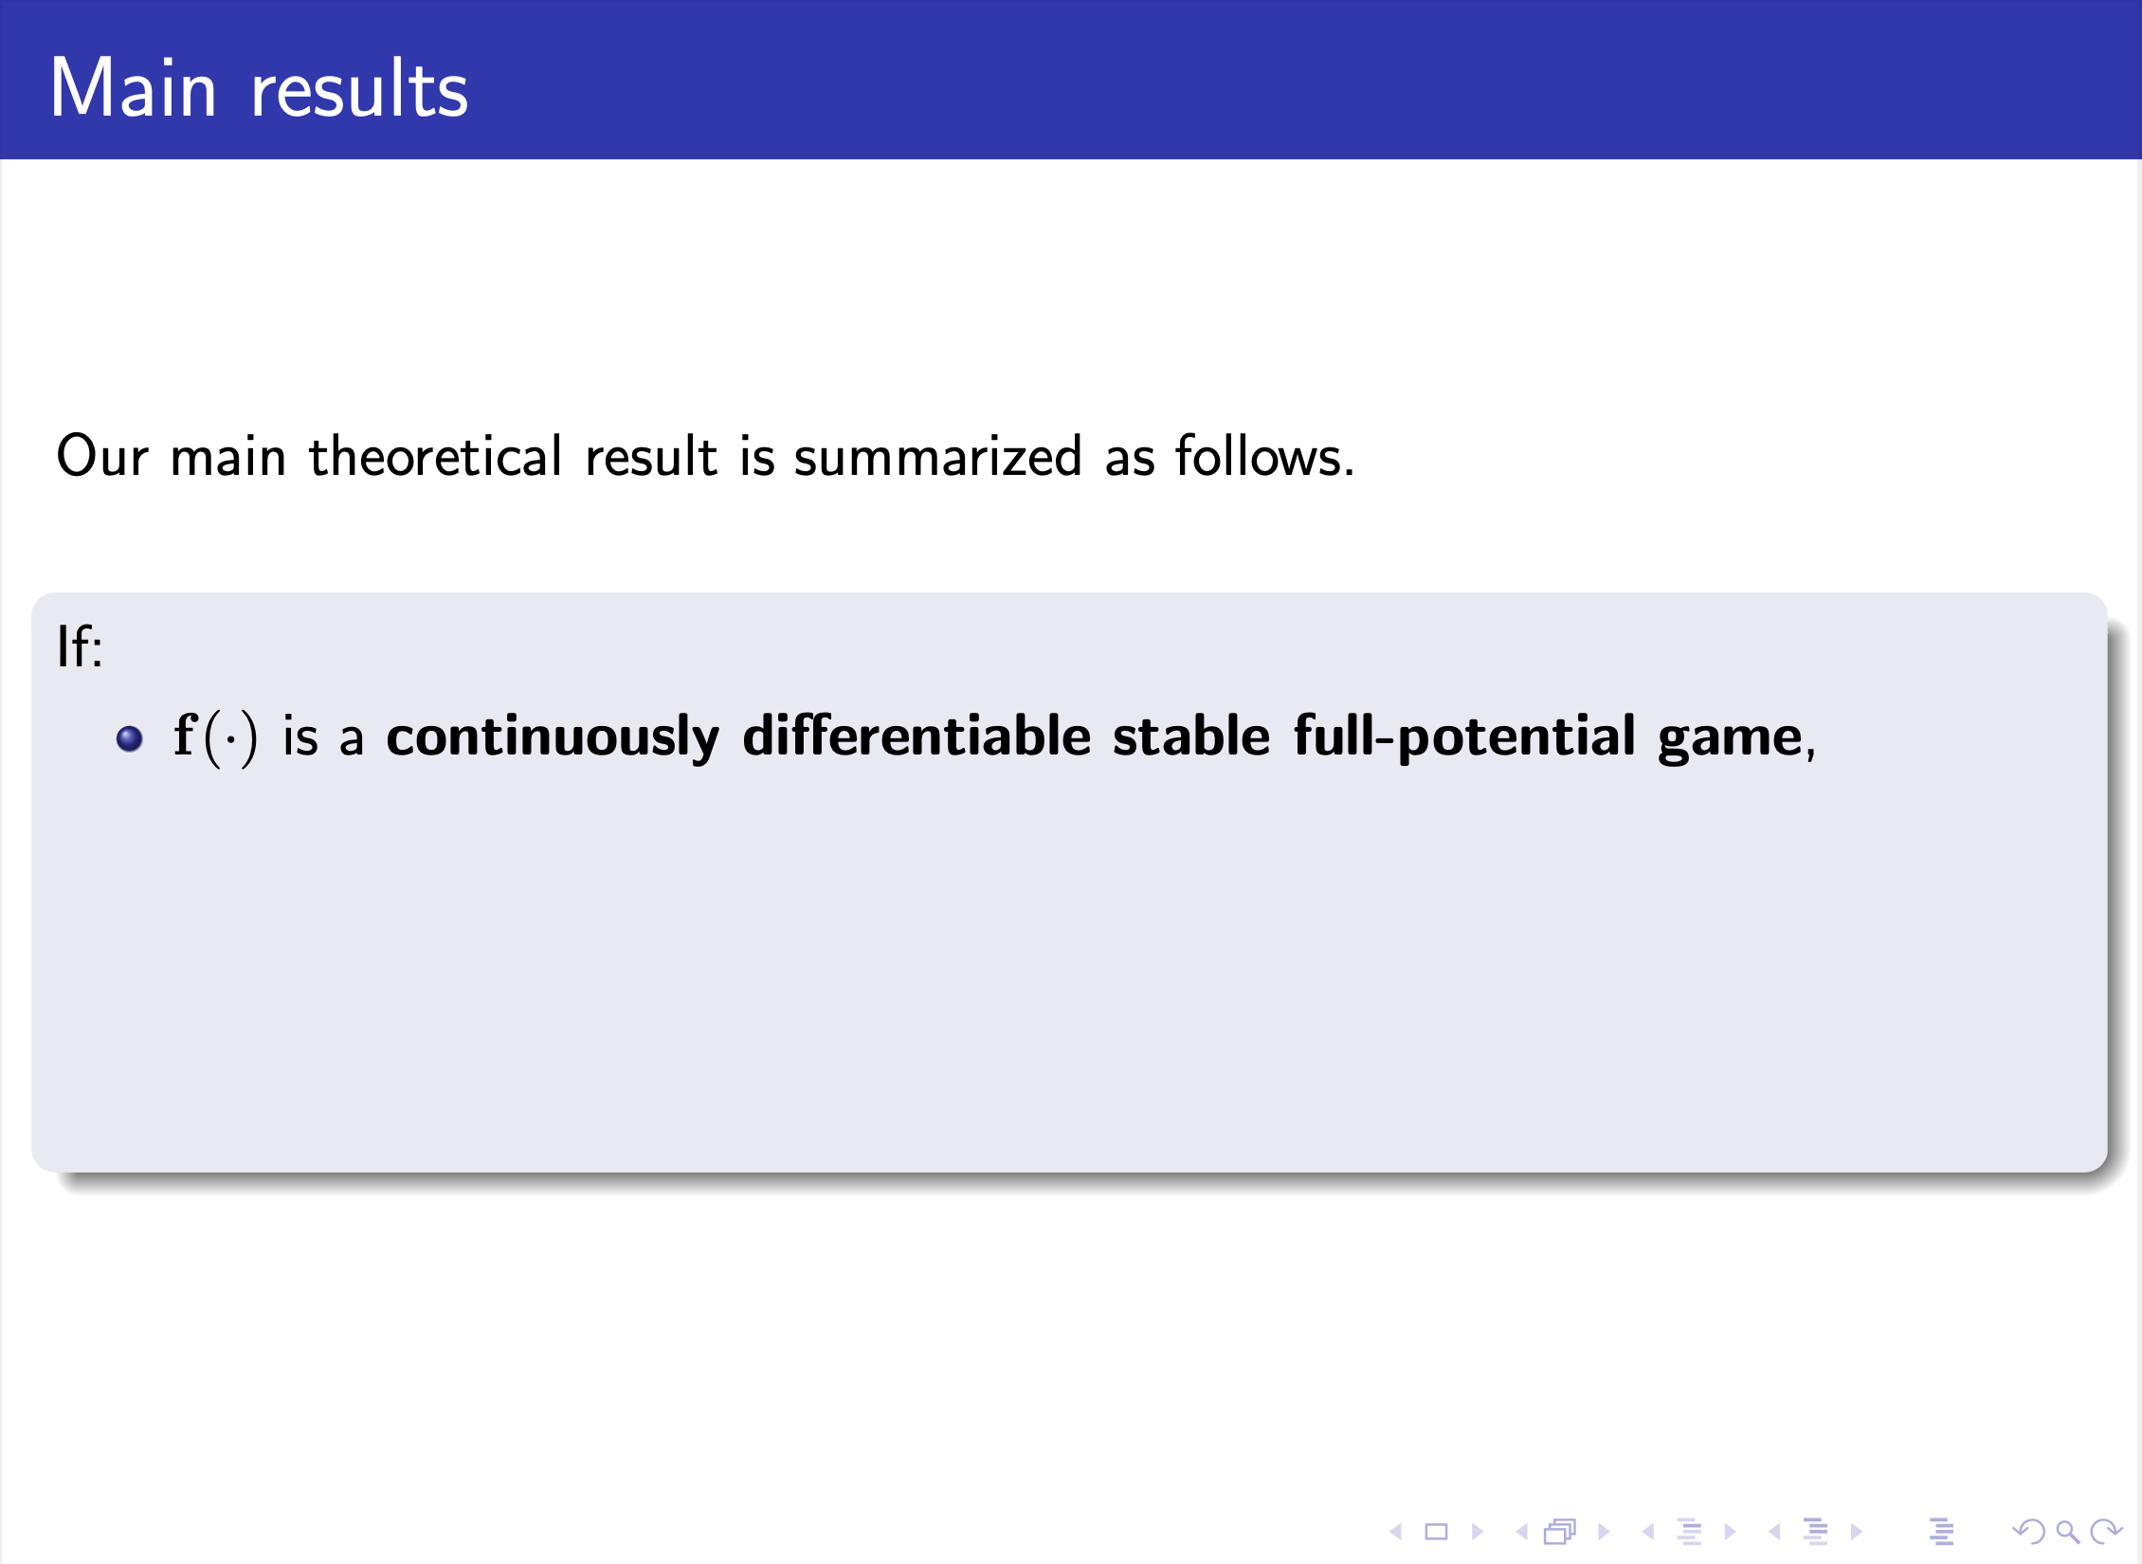
J.Martinez-Piazuelo, NQS, and C.Ocampo-Martinez, A Payoff Dynamics Model for Equality-Constrained Population Games, IEEE Control Systems Letters, 2022

Slide 75

J.Martinez-Piazuelo, NQS, and C.Ocampo-Martinez, A Payoff Dynamics Model for Equality-Constrained Population Games, IEEE Control Systems Letters, 2022

Slide 76

J.Martinez-Piazuelo, NQS, and C.Ocampo-Martinez, A Payoff Dynamics Model for Equality-Constrained Population Games, IEEE Control Systems Letters, 2022

Slide 77

J.Martinez-Piazuelo, NQS, and C.Ocampo-Martinez, A Payoff Dynamics Model for Equality-Constrained Population Games, IEEE Control Systems Letters, 2022

Slide 78

J.Martinez-Piazuelo, NQS, and C.Ocampo-Martinez, A Payoff Dynamics Model for Equality-Constrained Population Games, IEEE Control Systems Letters, 2022
Notes:
The set GNE(f) coincides with the maximizers of the potential function with the restrictions associated.

Slide 79

Notes:
Let us consider a congestion game, where a large number of agents must travel from point A to terminals B, C, and D.

Slide 80

Notes:
A → B: S1-S2; A → C: S3-S4-S5; A → D: S6-S7

Slide 81

Notes:
Assume 20% agents should reach B and 60% C

Slide 82

Notes:
In addition, the total congestion cost of the transportation network is given by the quadratic function varphi.

Slide 83

Notes:
We can see the proportion of agents that reach an optimal distribution strategy. The PDM converges to the optimal values of the dual optimization values as we can see in the lower figure.

Slide 84
Some Other References…
J.Martinez-Piazuelo, NQS, C.Ocampo-Martinez, Nash equilibrium seeking in full-potential population games under capacity and migration constraints, Automatica, 2022
J.Martinez-Piazuelo, NQS, C.Ocampo-Martinez, A payoff dynamics model for generalized Nash equilibrium seeking in population games , Automatica, 2022
J.Martinez-Piazuelo, NQS, C.Ocampo-Martinez, Decentralized Charging Coordination of Electric Vehicles under Feeder Capacity Constraints, IEEE Transactions on Control of Network Systems, 2022

Slide 85


Other Applications…
J. Martinez-Piazuelo, G. Diaz-Garcia, NQS, and L. F. Giraldo. Discrete-time Distributed Population Dynamics For Optimization and Control. IEEE Transactions on Systems Man and Cybernetics, 2022.
J. Barreiro-Gomez, I. Mas, J. I. Giribet, P. Moreno, C. Ocampo-Martinez, R. Sánchez-Peña, NQS, Distributed Data-Driven UAV Formation Control Via Evolutionary Games: Experimental Results, Journal of the Franklin Institute, 2021
Notes:
Some other applications have been developed using these population dynamics methods. For instance, we have here two examples of formation control on unmanned vehicles. The one on the bottom corresponds to some UAVs that should be deployed in a formation to supervise what is happening depending the location. The other video shows how the population games and evolutionary dynamics evolve depending on different type of networks. As you can see there are some issues regarding the type of information that the agents are receiving.

Slide 86

Conclusions
Population games and evolutionary dynamics are very useful to solve large-scale control systems problems.
We have presented our general approach, and the methodology applied to address different type of problems.
There are several open problems on dynamic resource allocation where this type of strategies can be used.
J. Martinez-Piazuelo, G. Diaz-Garcia, NQS, and L. F. Giraldo. Discrete-time Distributed Population Dynamics For Optimization and Control. IEEE Transactions on Systems Man and Cybernetics, 2022.
Notes:
In this talk, we have presented population games and evolutionary dynamics, which are very useful to solve large-scale control systems problems.
We have presented our general approach, and the methodology applied to address different type of problems.
There are several open problems on dynamic resource allocation where this type of strategies can be used.

Slide 87












Slide 88



A.Pantoja, E.Mojica-Nava, G.Obando, J.Barreiro, C.Ocampo, A.Cadena, A.Pedraza, J.Giraldo, L.F.Giraldo, C.Barreto, J.Barco, J.Poveda, A.M.Ospina, S.Amaya, D.Mahecha, I.Muñoz, D.Téllez, E.Escobar, G.Riaño, J.L.Morillo, M.Velásquez, J.Rojas, A.Betancur, C.Macana, D.Díaz, E.Ramírez, A.Cortés, M.Parra, J.Cristancho, A.Sierra, C.Caro, S.Jiménez, Y.Chacón, C.García, A.Ramírez, D.de la Torre, A.Castro, P.Ñañez, ,R.Sanfelice, D.Villa, A.Rengifo, F.Segura, L.F.Cómbita, A.Cárdenas, O.Torres, L.Burbano, D.Ochoa, G.Conde, J.Maestre, R.Sanchez-Peña, J.López, J.P.Martínez, D.Gómez, O.Archila, A.Murcia, M.A.Sandoval, J.E.Díaz, J.S.Villalba, J.S.González, G.Díaz, S.Rueda, L.A.Guzmán, M.Espinosa, J.P.Rodríguez, M.Rodríguez, J.Guevara, H.Vargas, J.Mariño, G.Jiménez, J.Saldarriaga, A.Vande Wouwer.

